Slide 1
2heads
Tic-tac-toe v2.0

Slide 2
2heads - Tic-tac-toe v2.0
Objectives

Slide 3
2heads - Tic-tac-toe v2.0
Objectives
• Implement simple AI functionality
• Perform some major refactoring

Slide 4
2heads - Tic-tac-toe v2.0
Let’s play

Slide 5
2heads - Tic-tac-toe v2.0
Refactoring

Slide 6
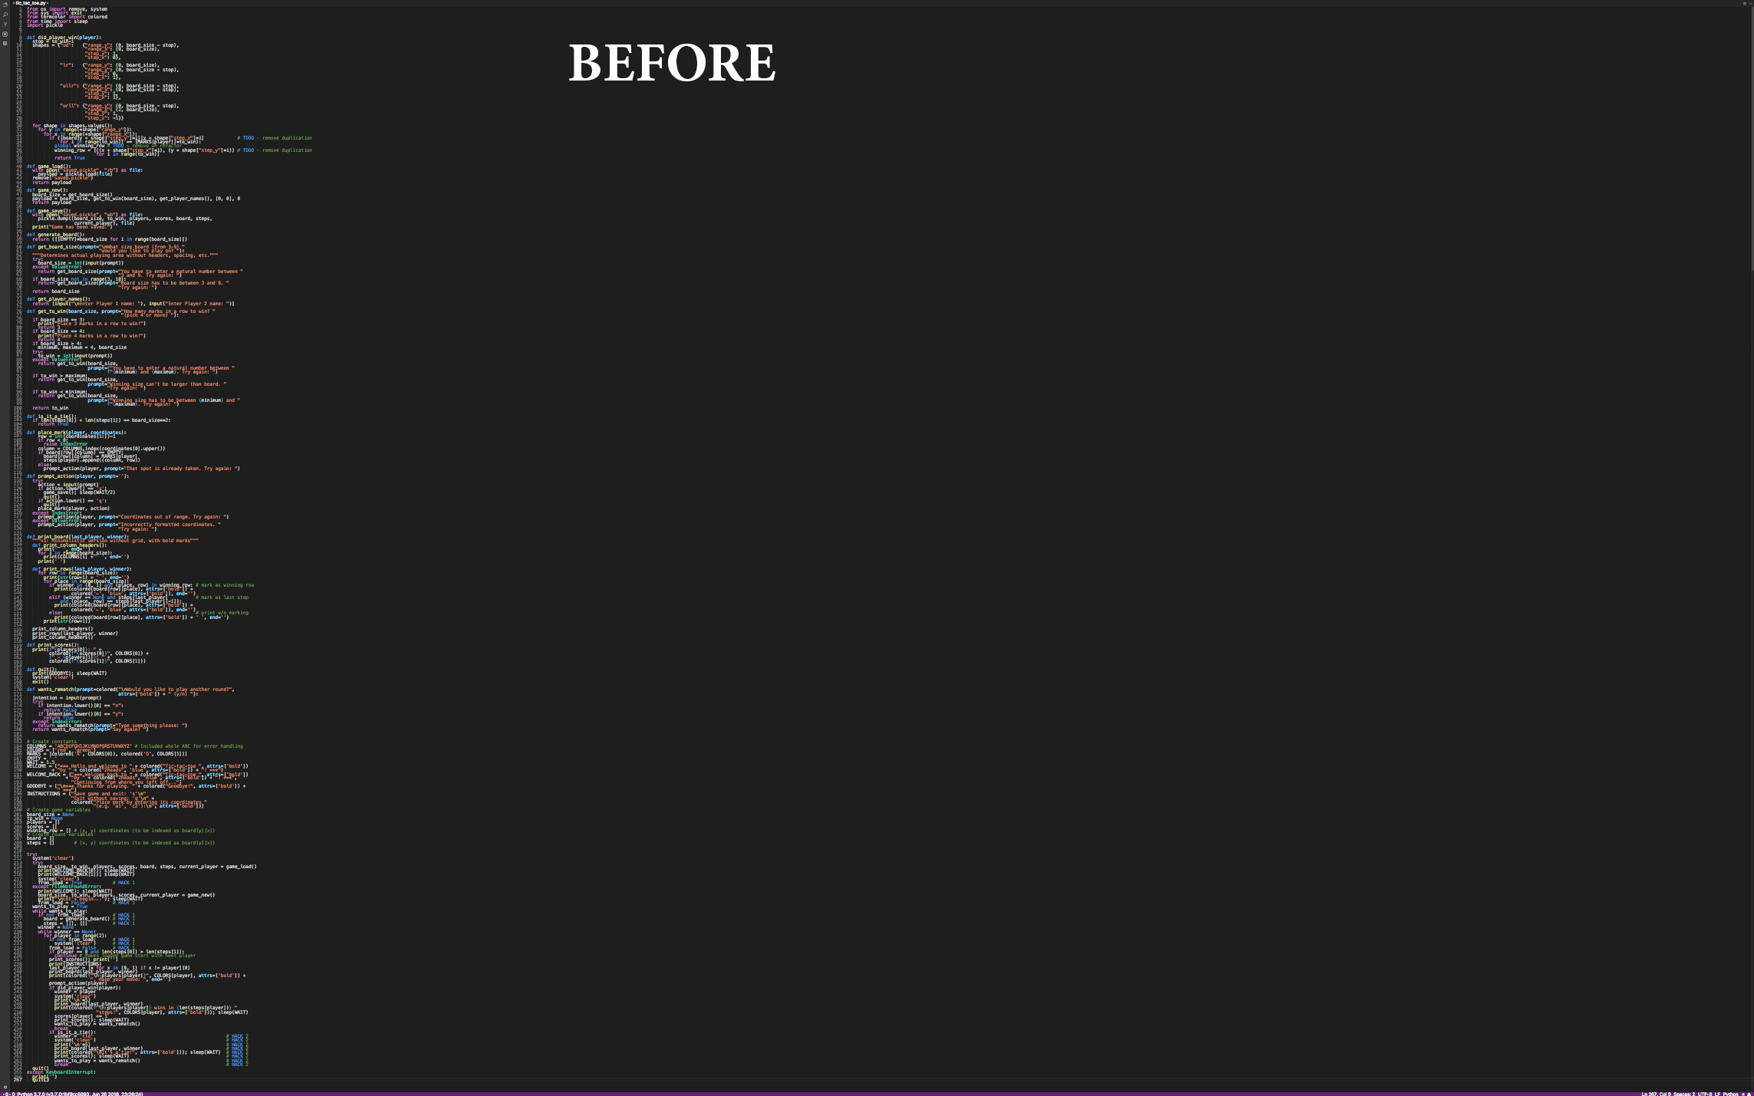

Slide 7
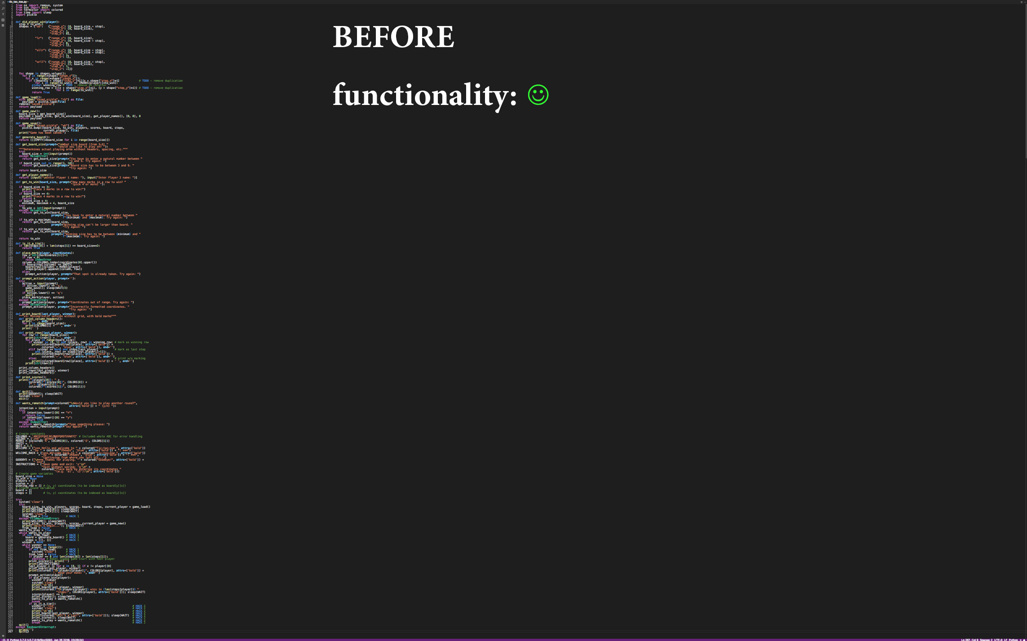

Slide 8
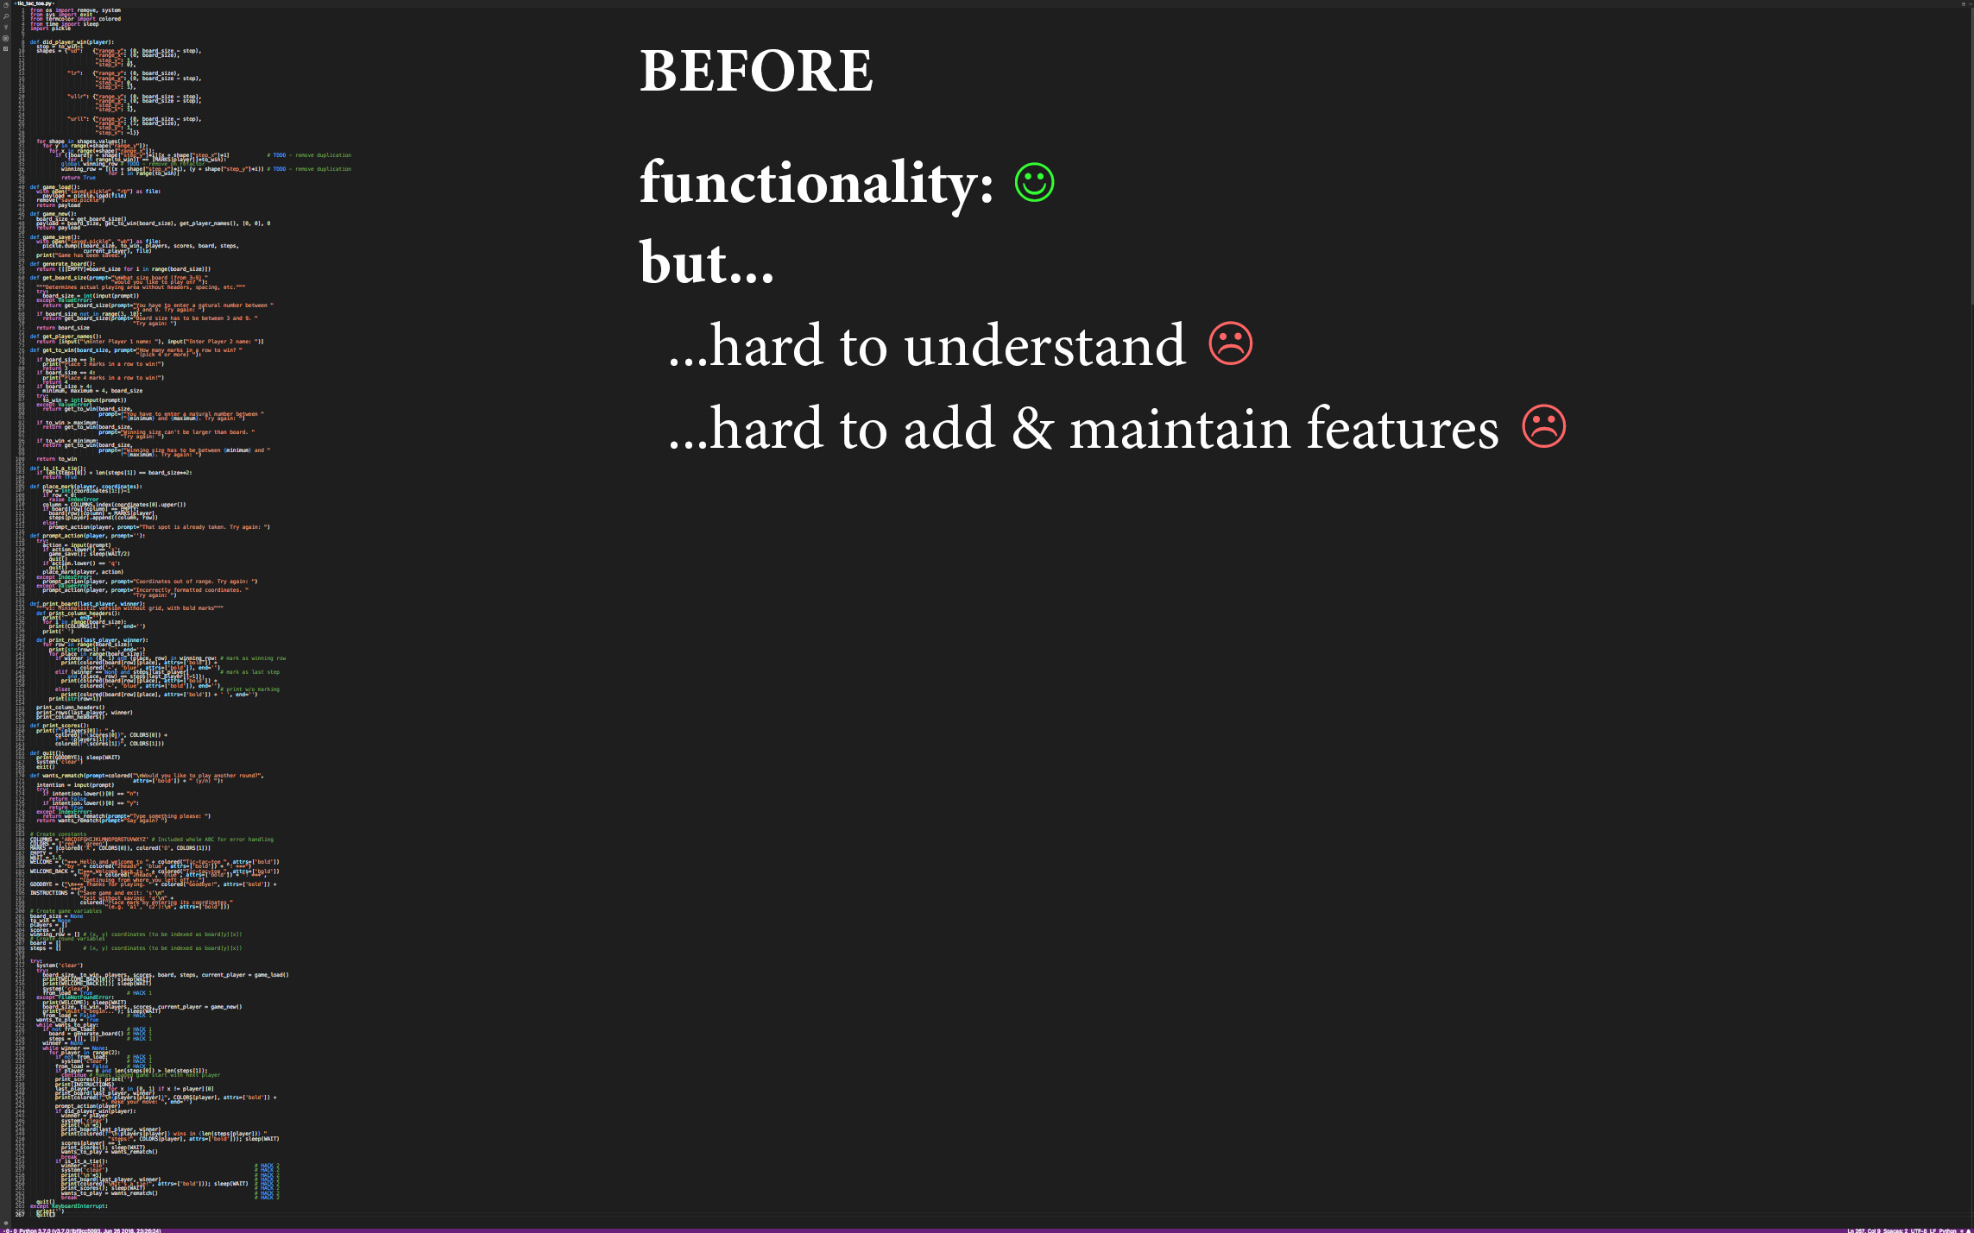

Slide 9
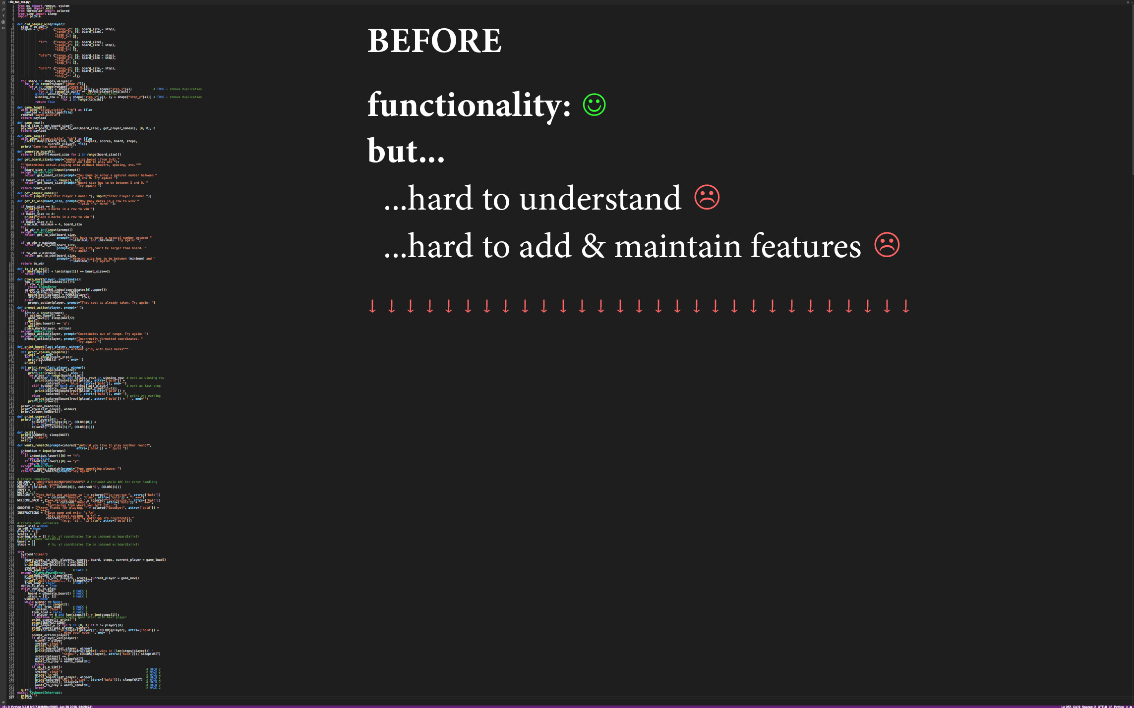

Slide 10
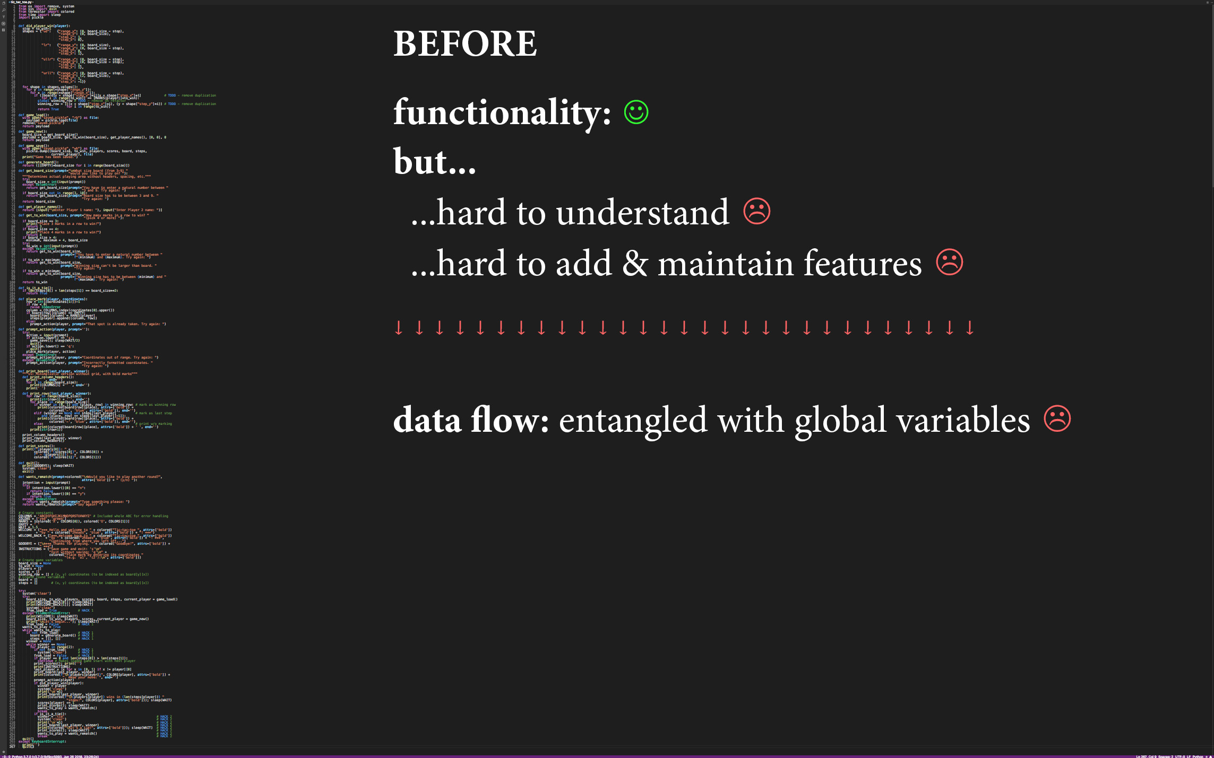

Slide 11
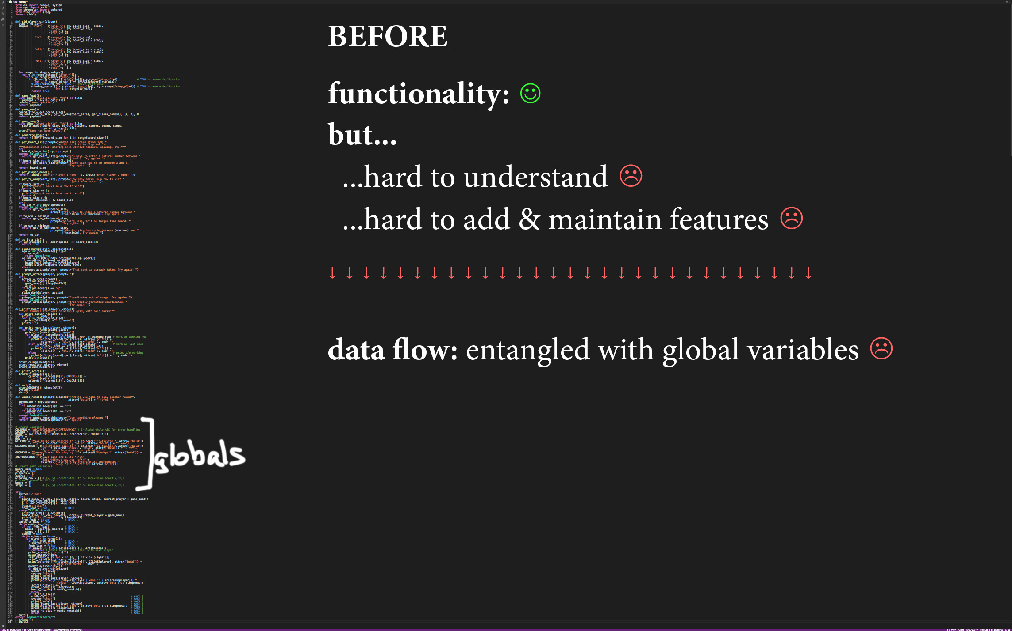

Slide 12
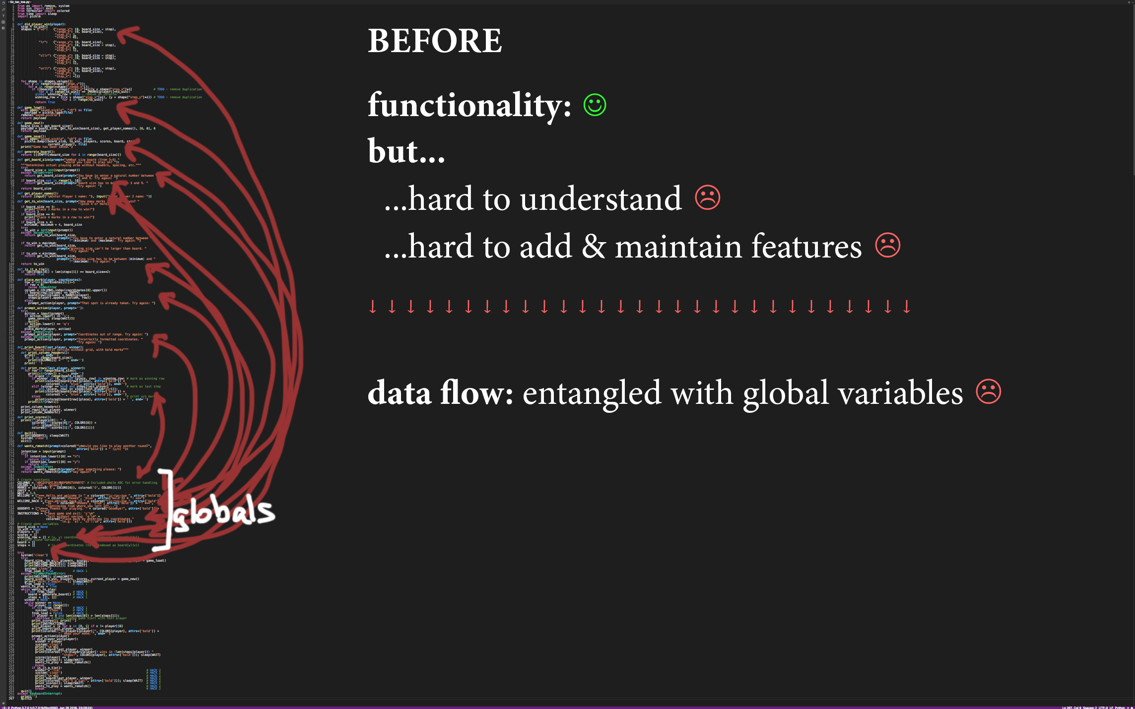

Slide 13
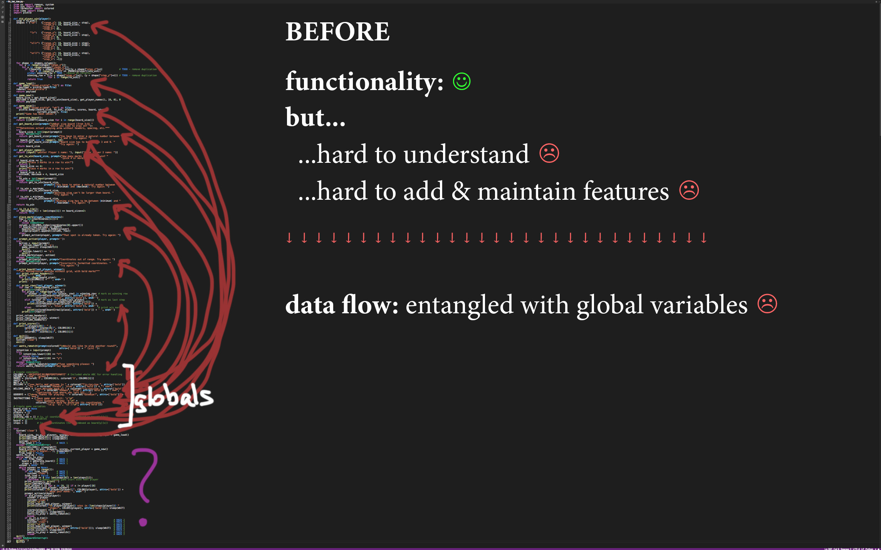

Slide 14
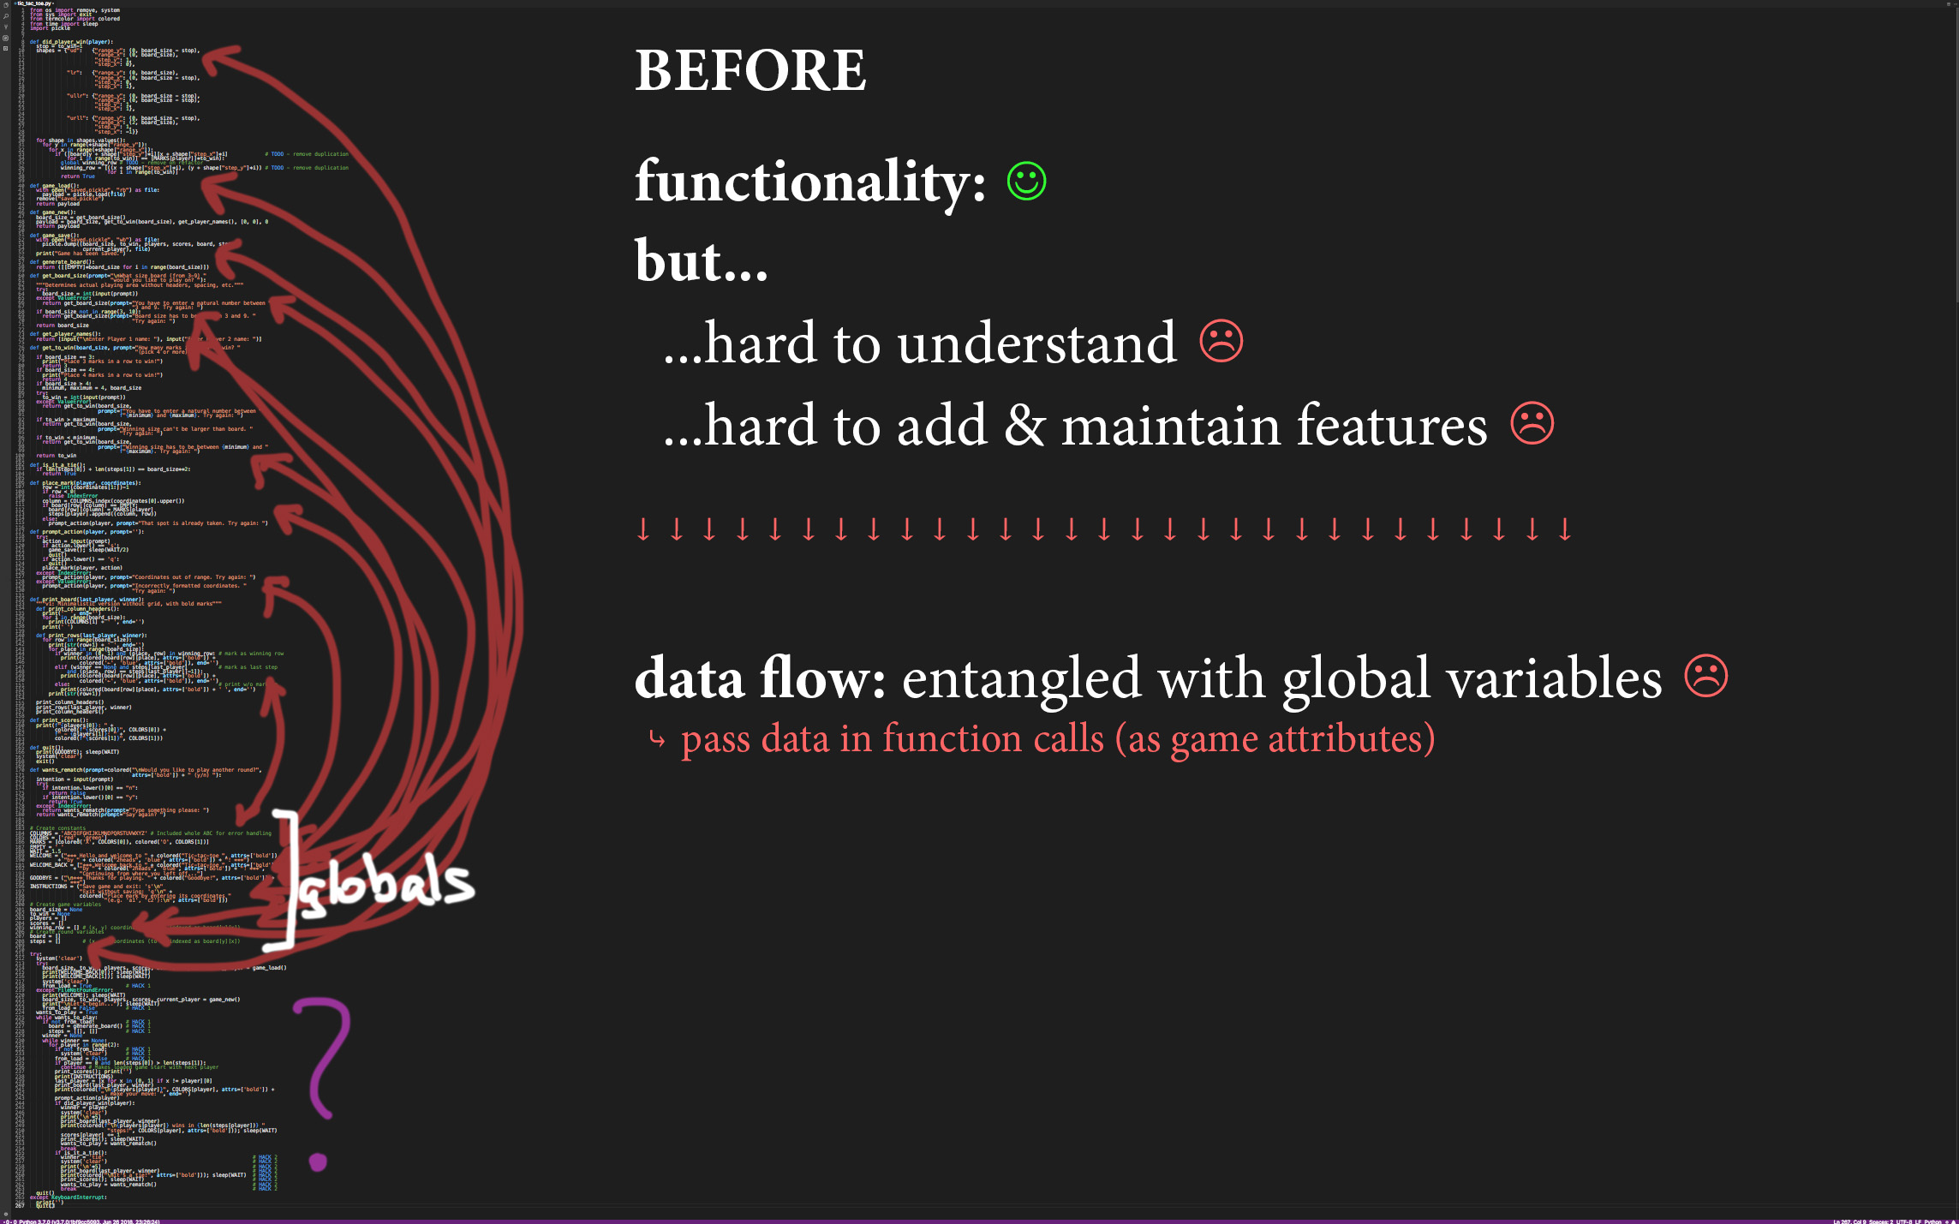

Slide 15
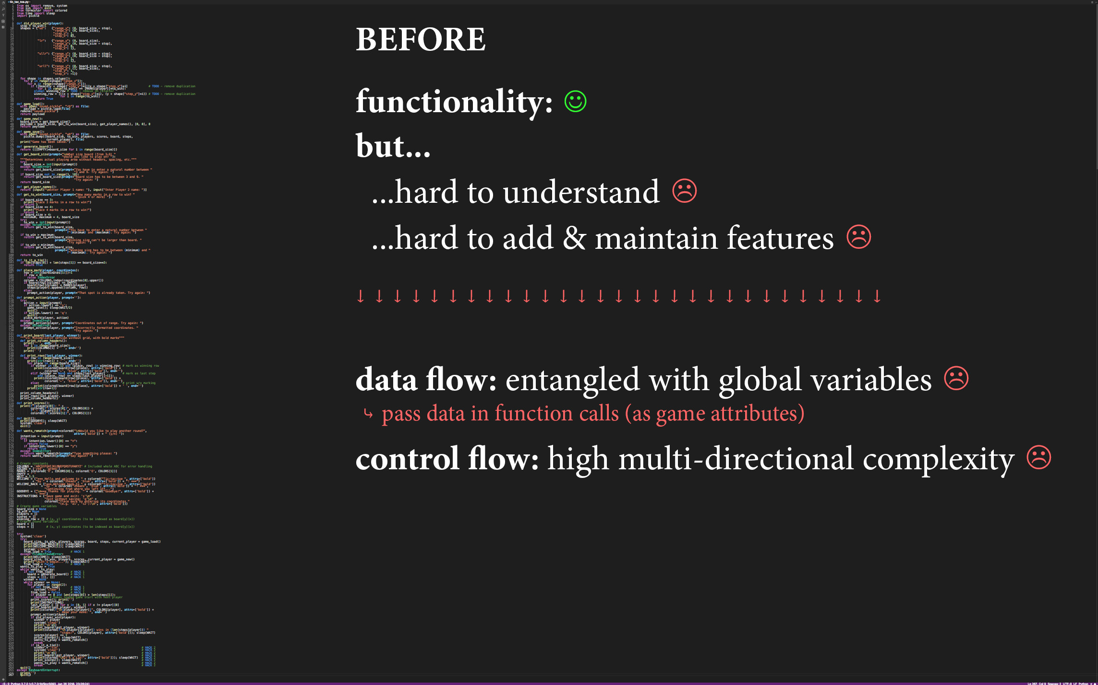

Slide 17
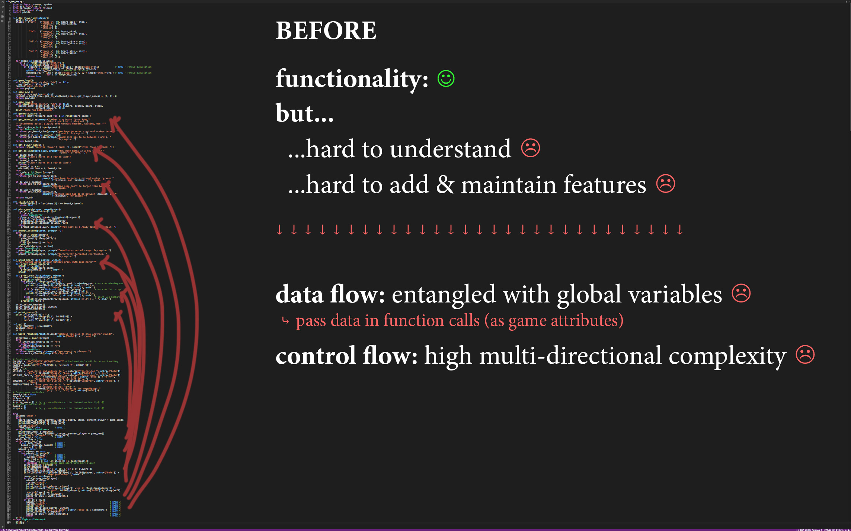

Slide 18
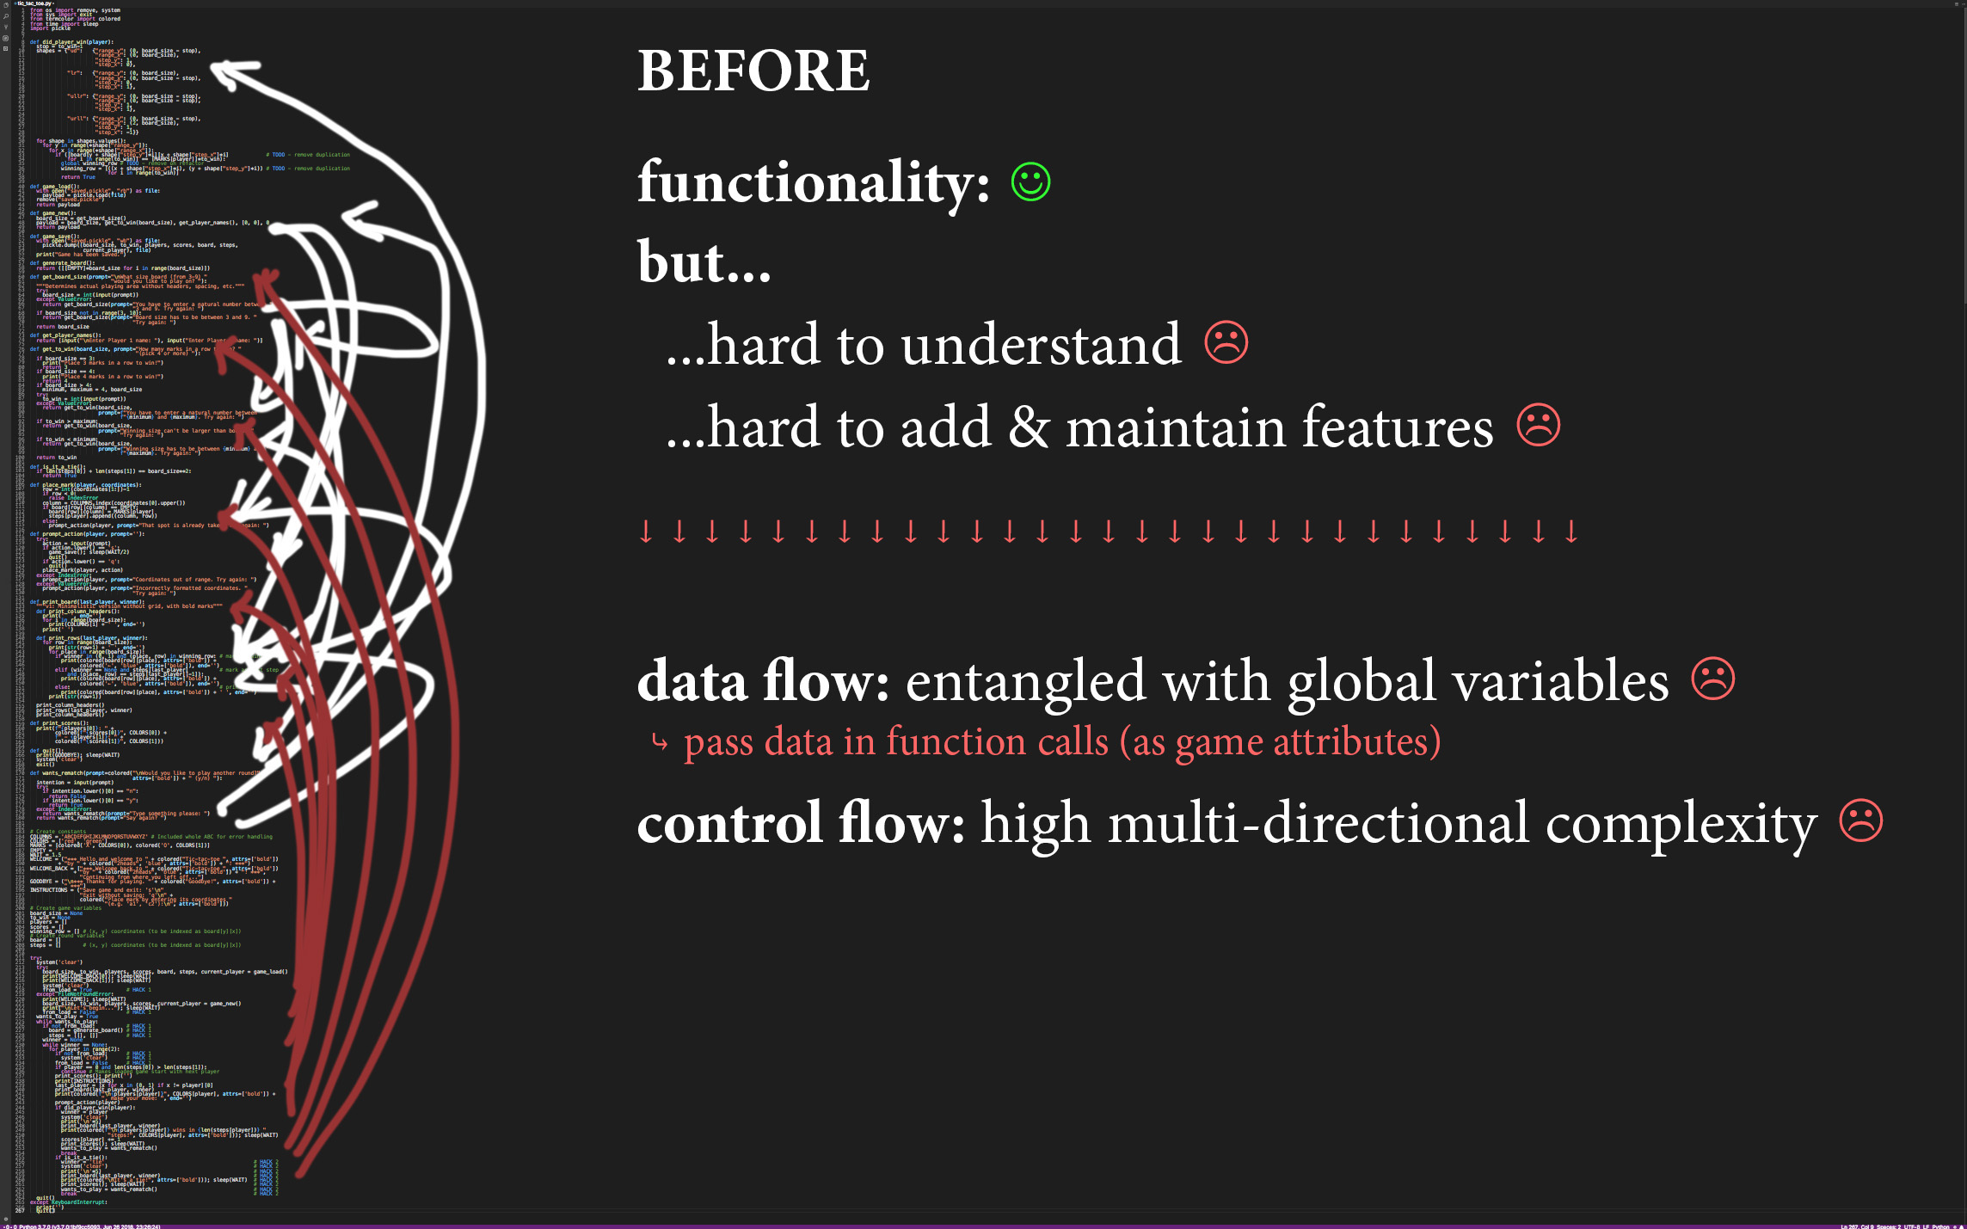

Slide 19
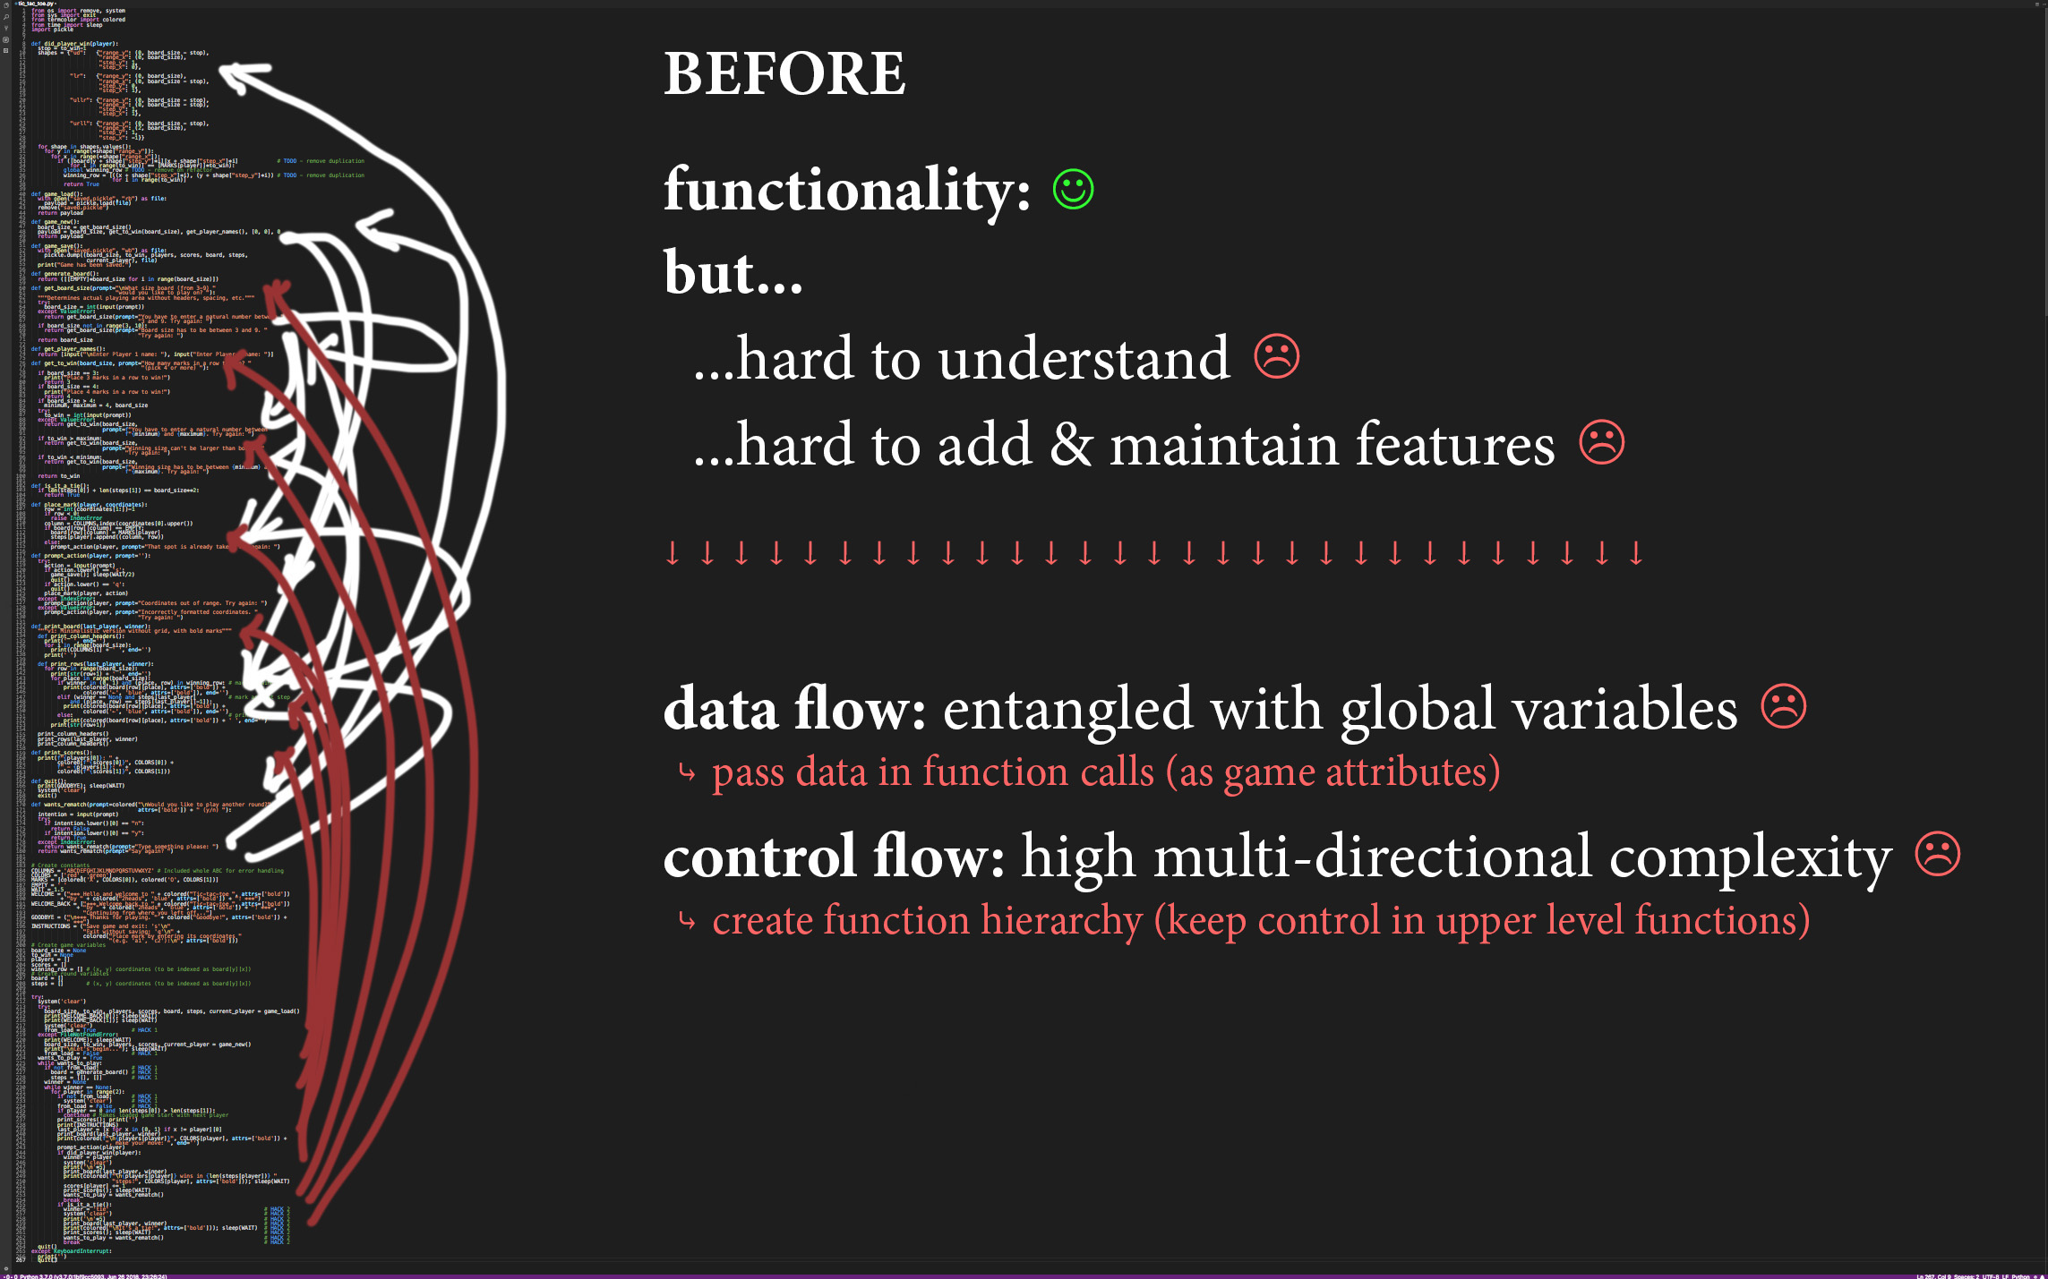

Slide 20
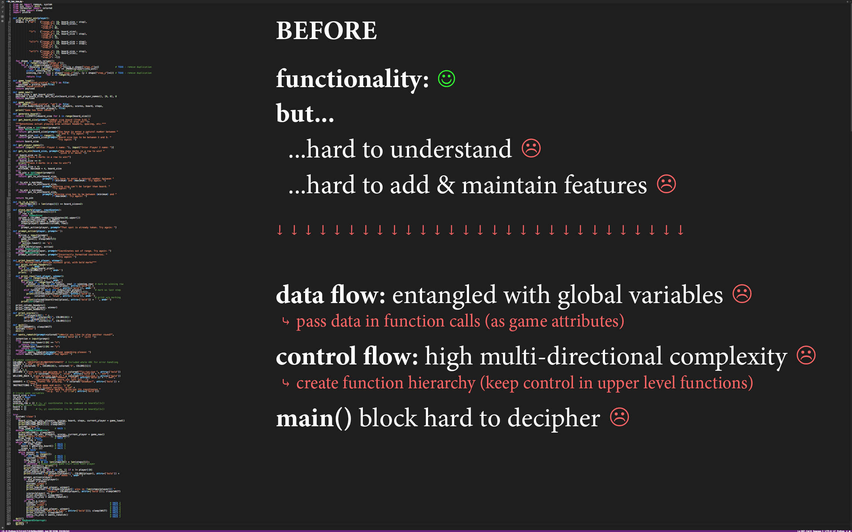

Slide 21
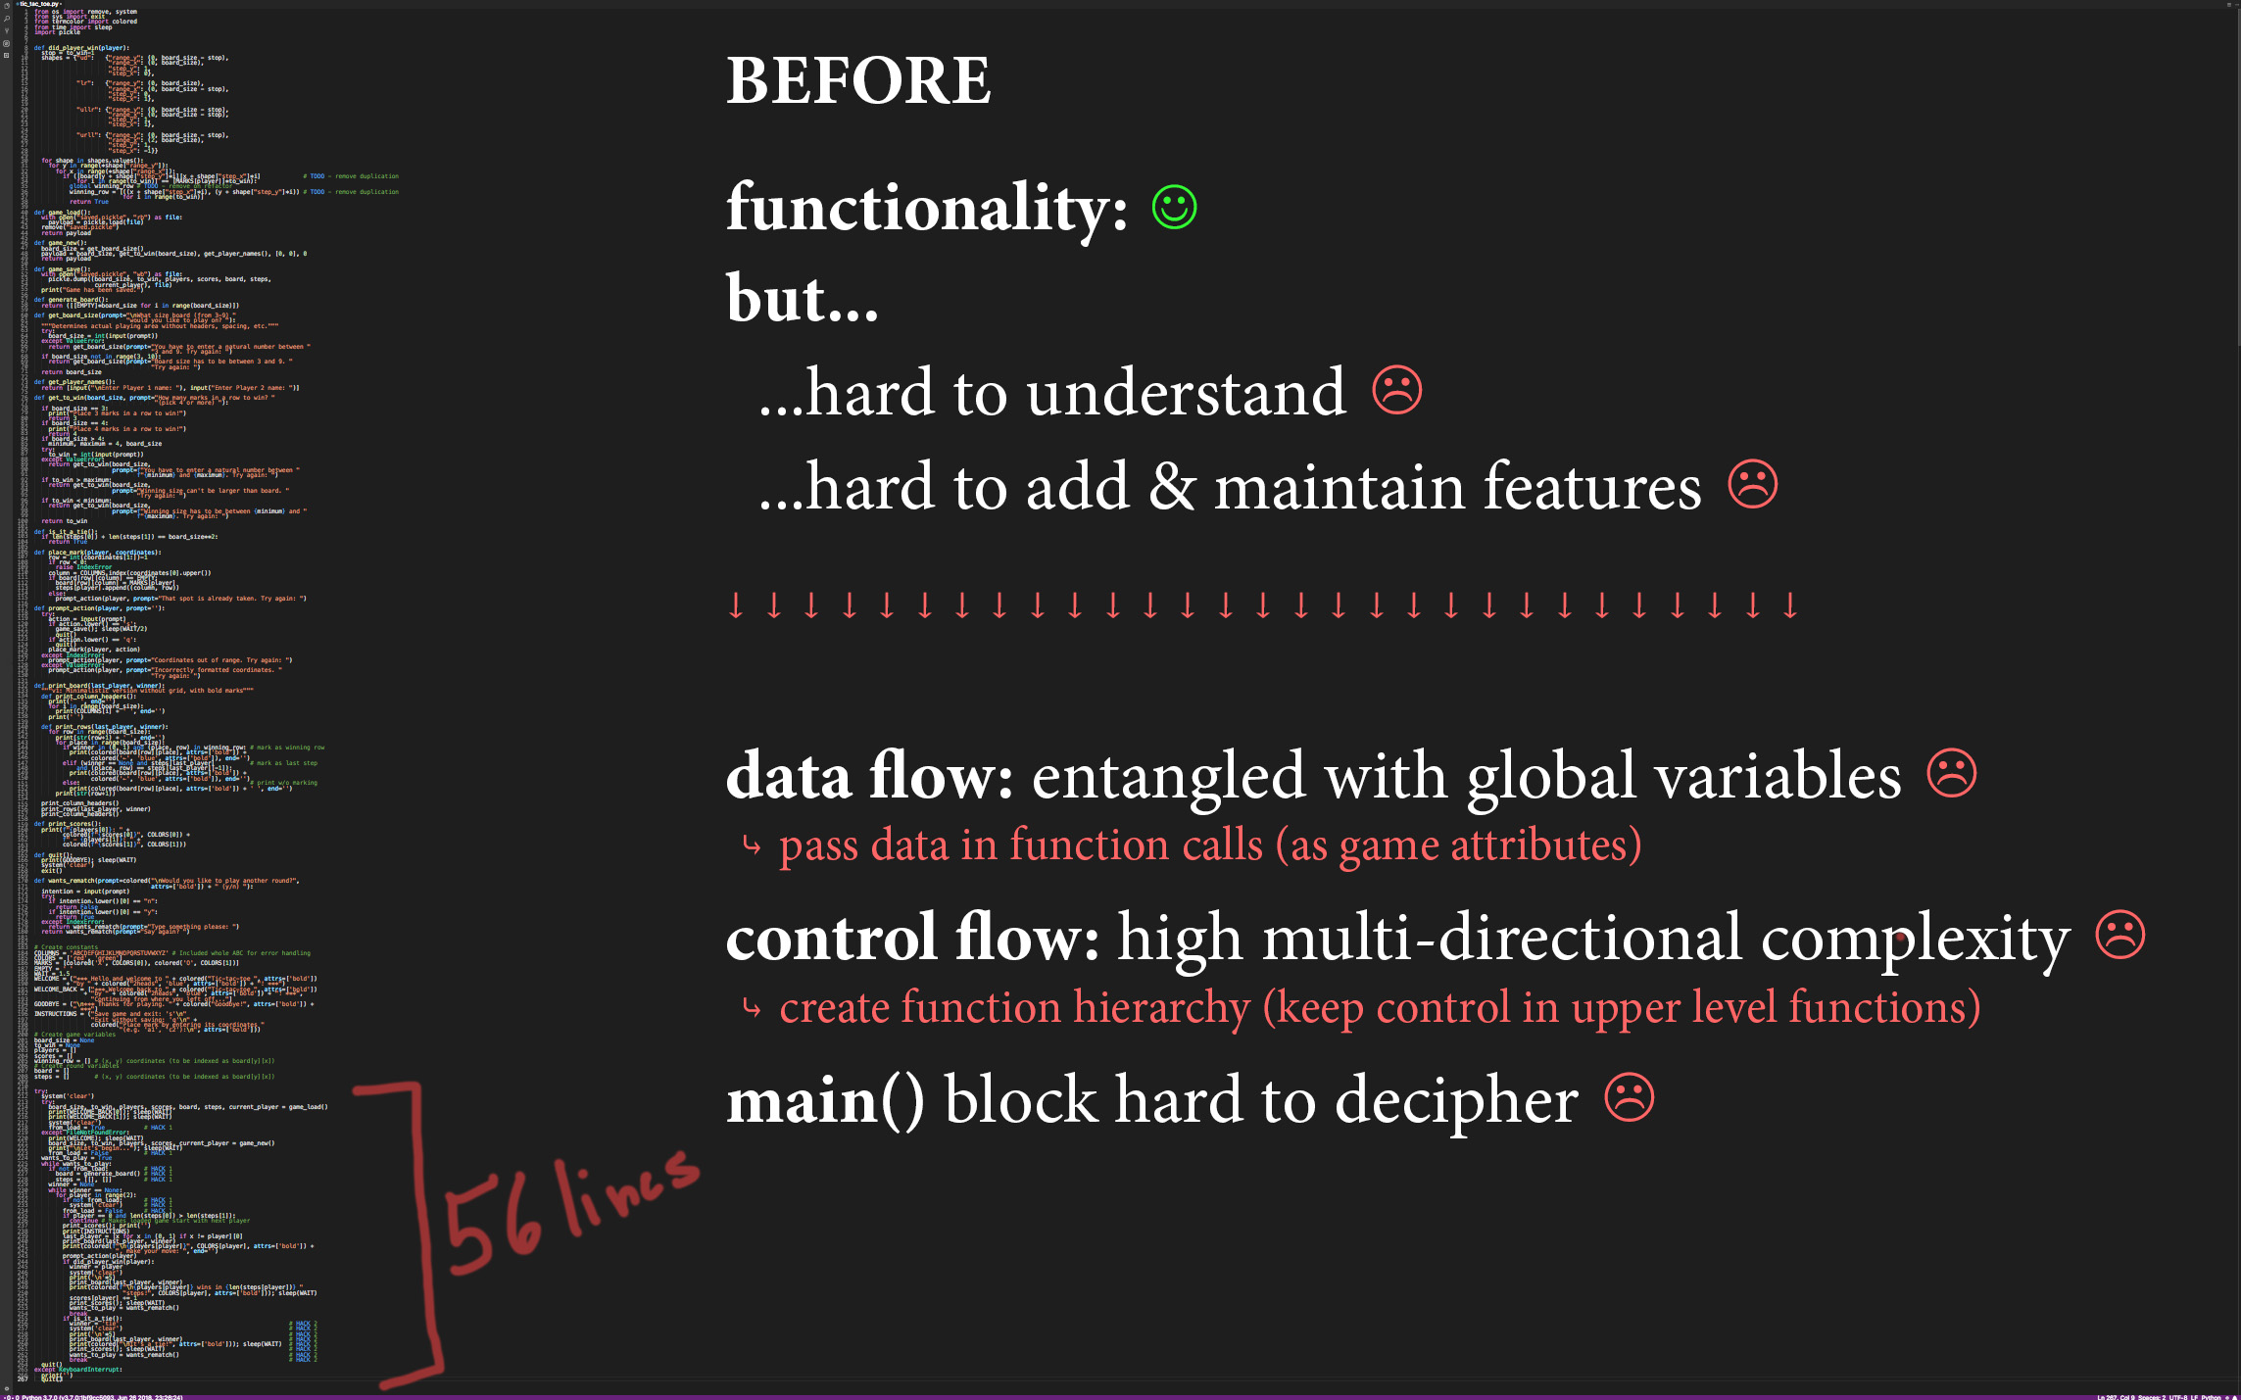

Slide 22
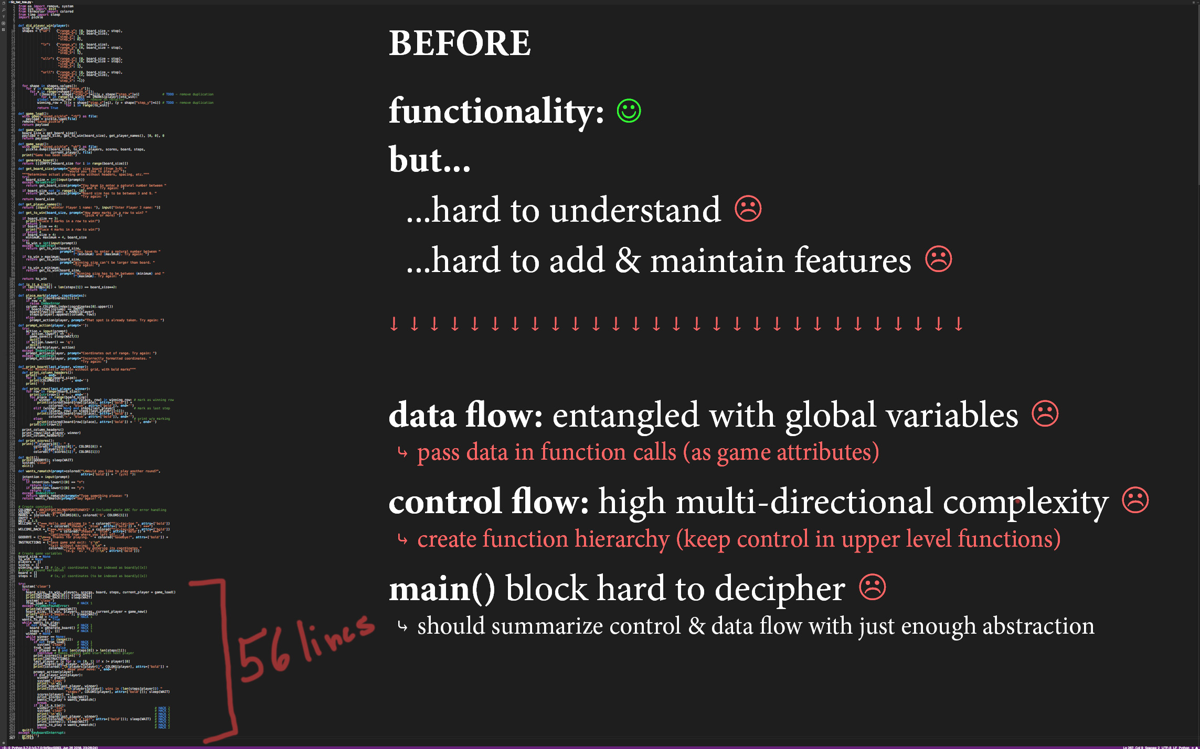

Slide 23
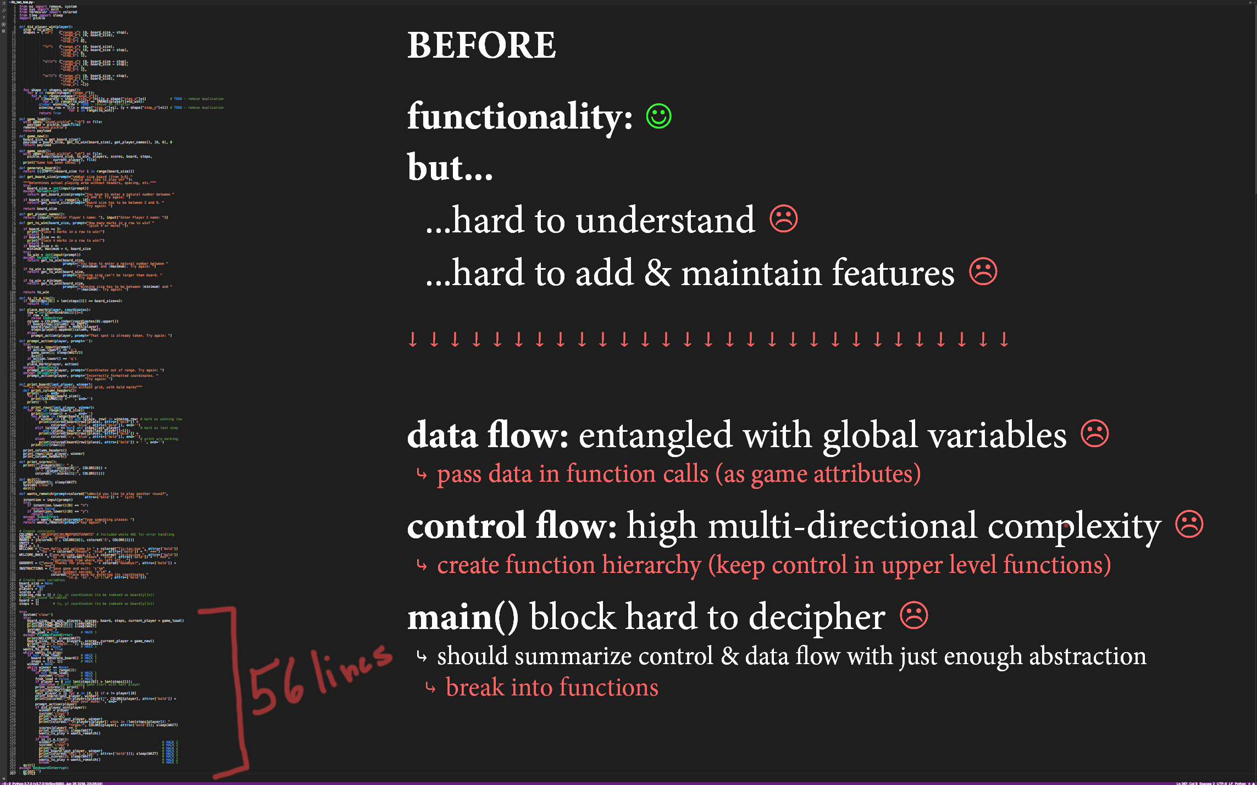

Slide 24
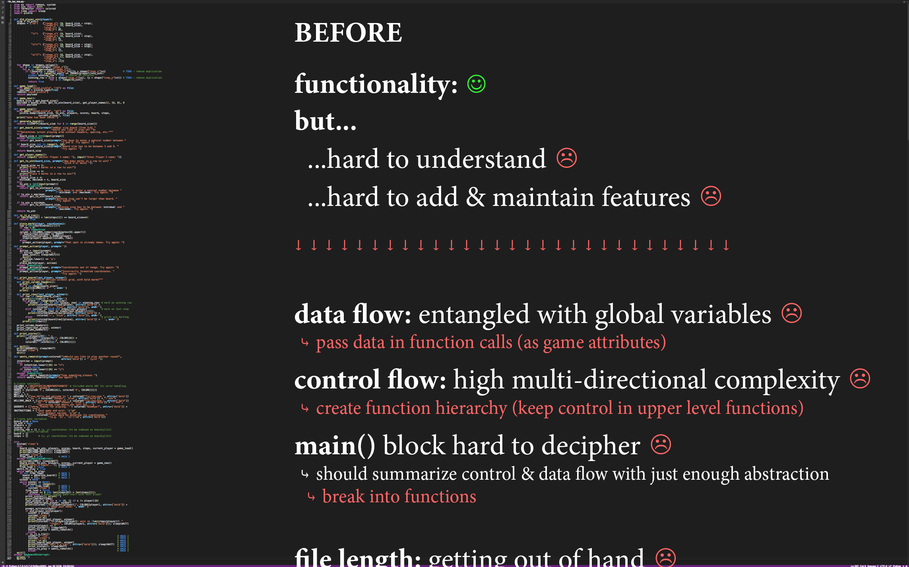

Slide 25
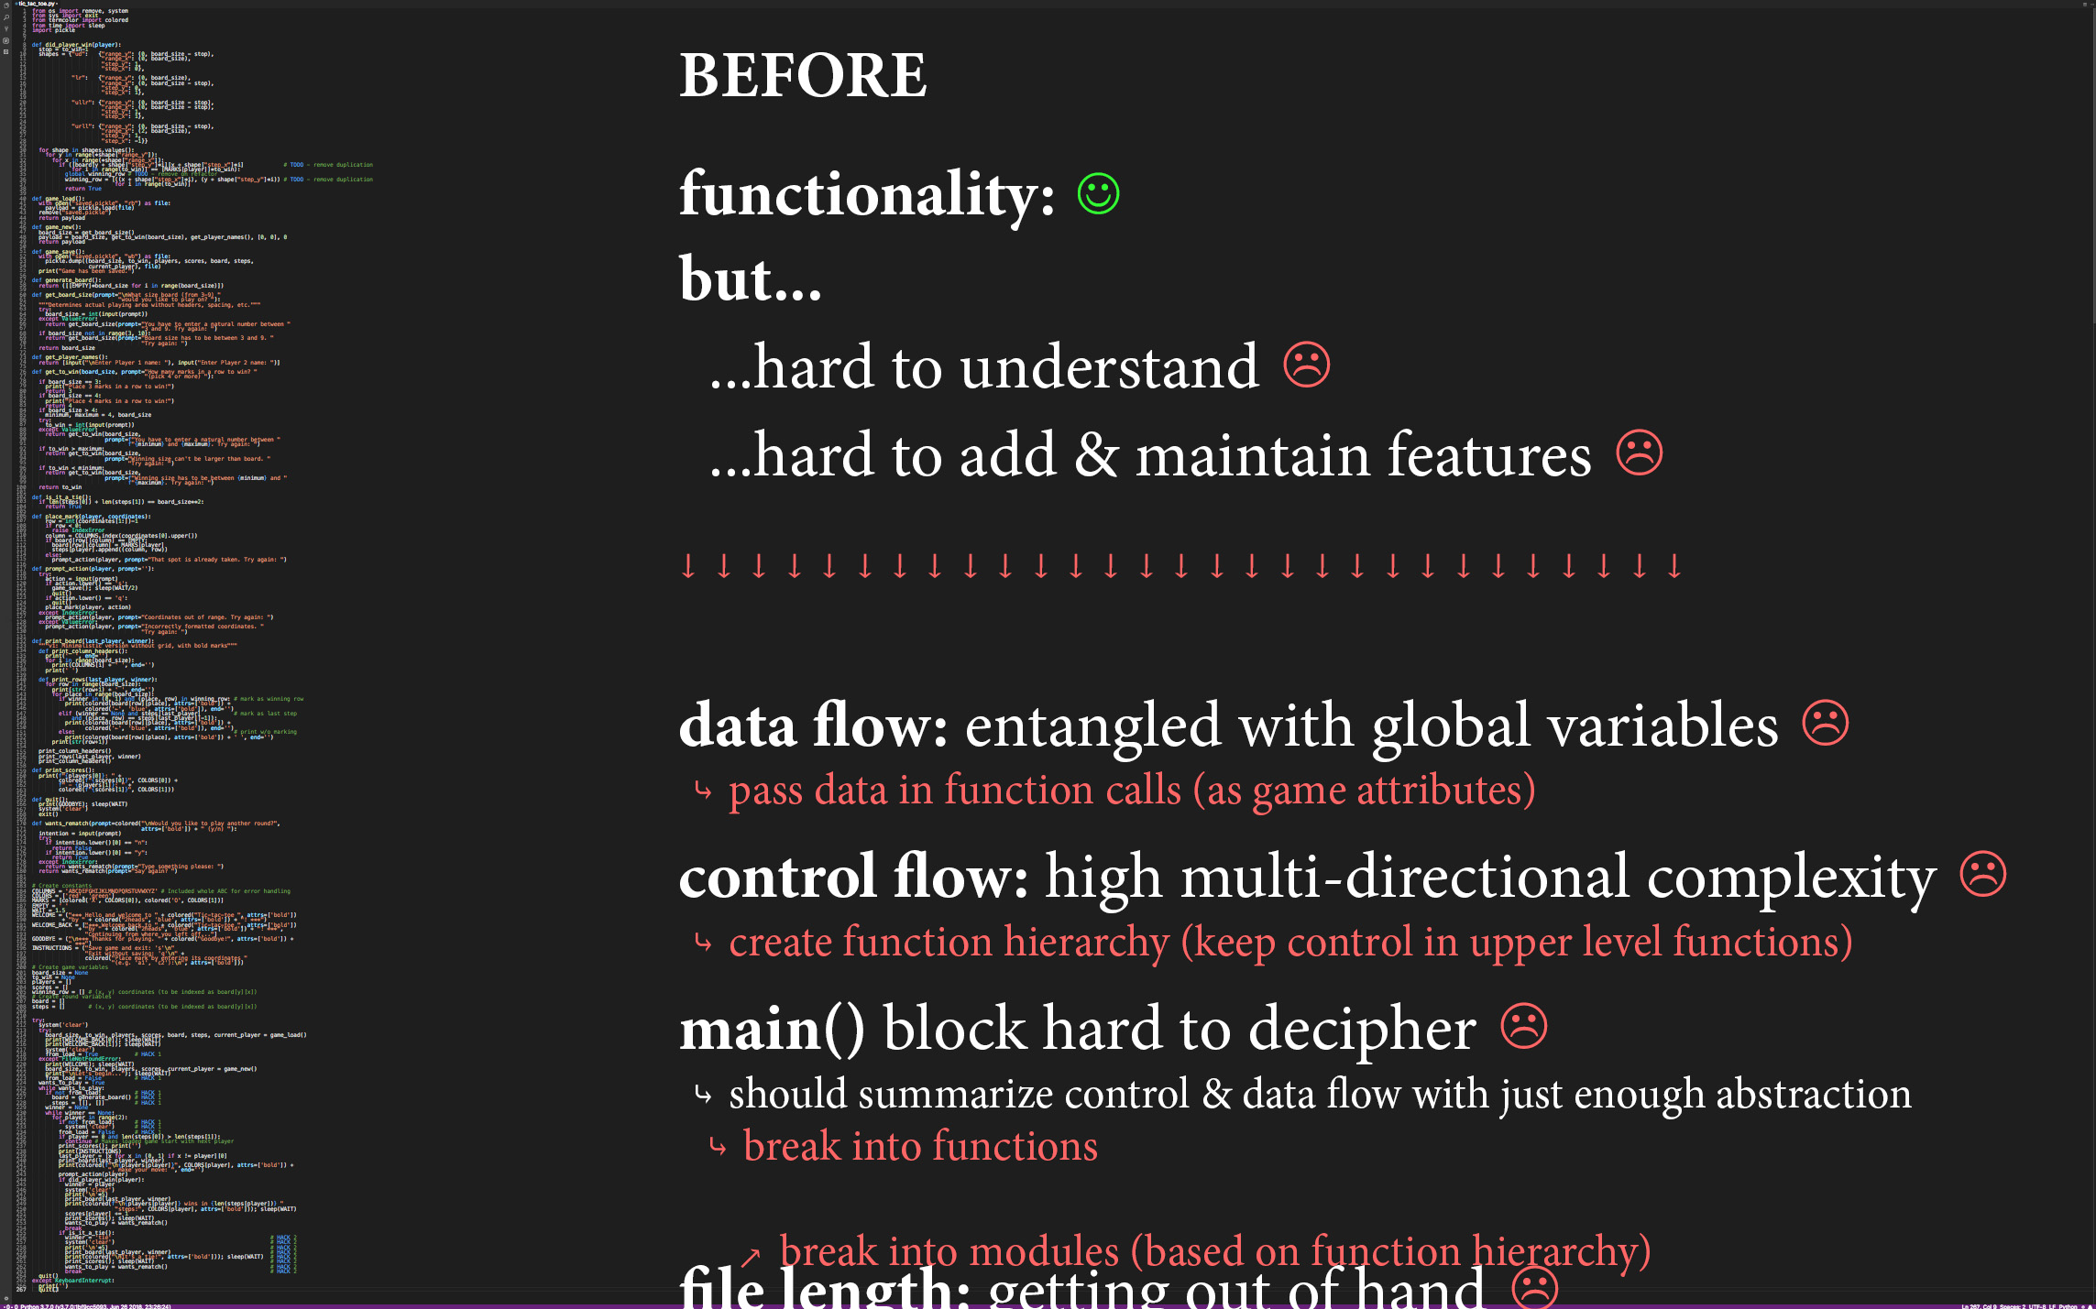

Slide 26
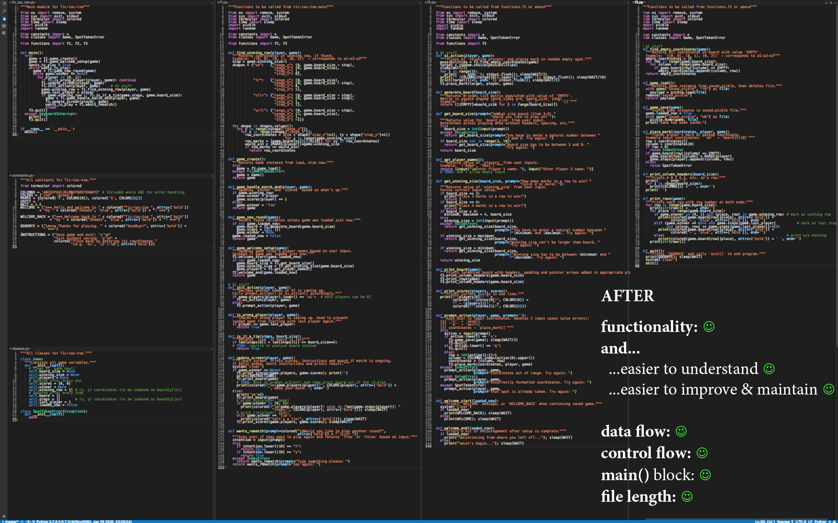

Slide 27
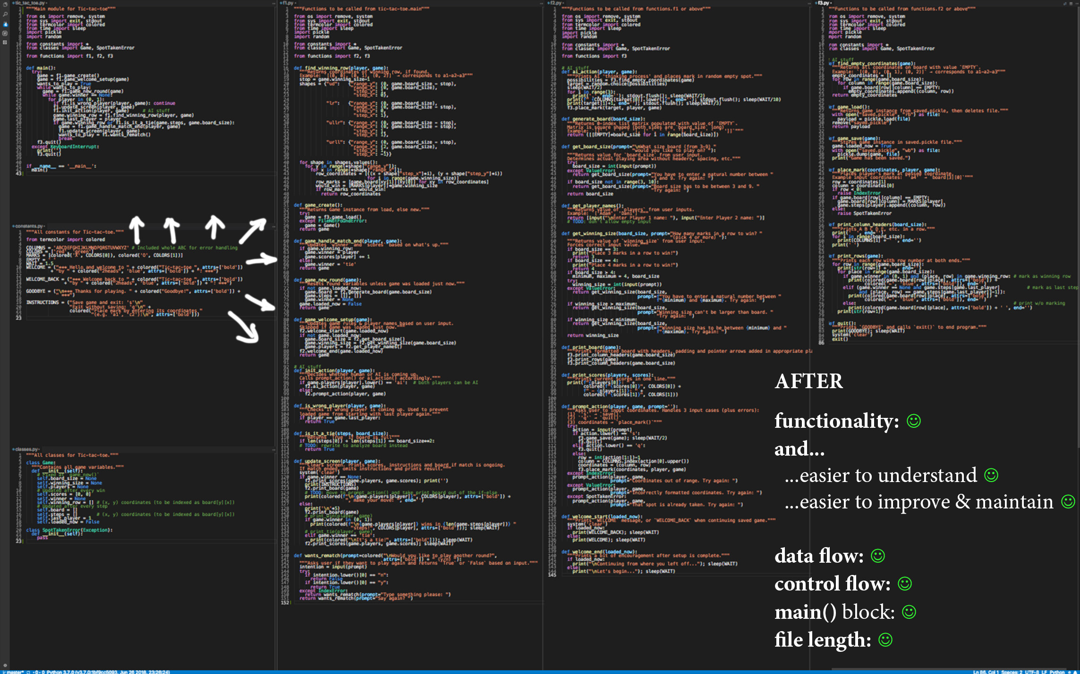

Slide 28
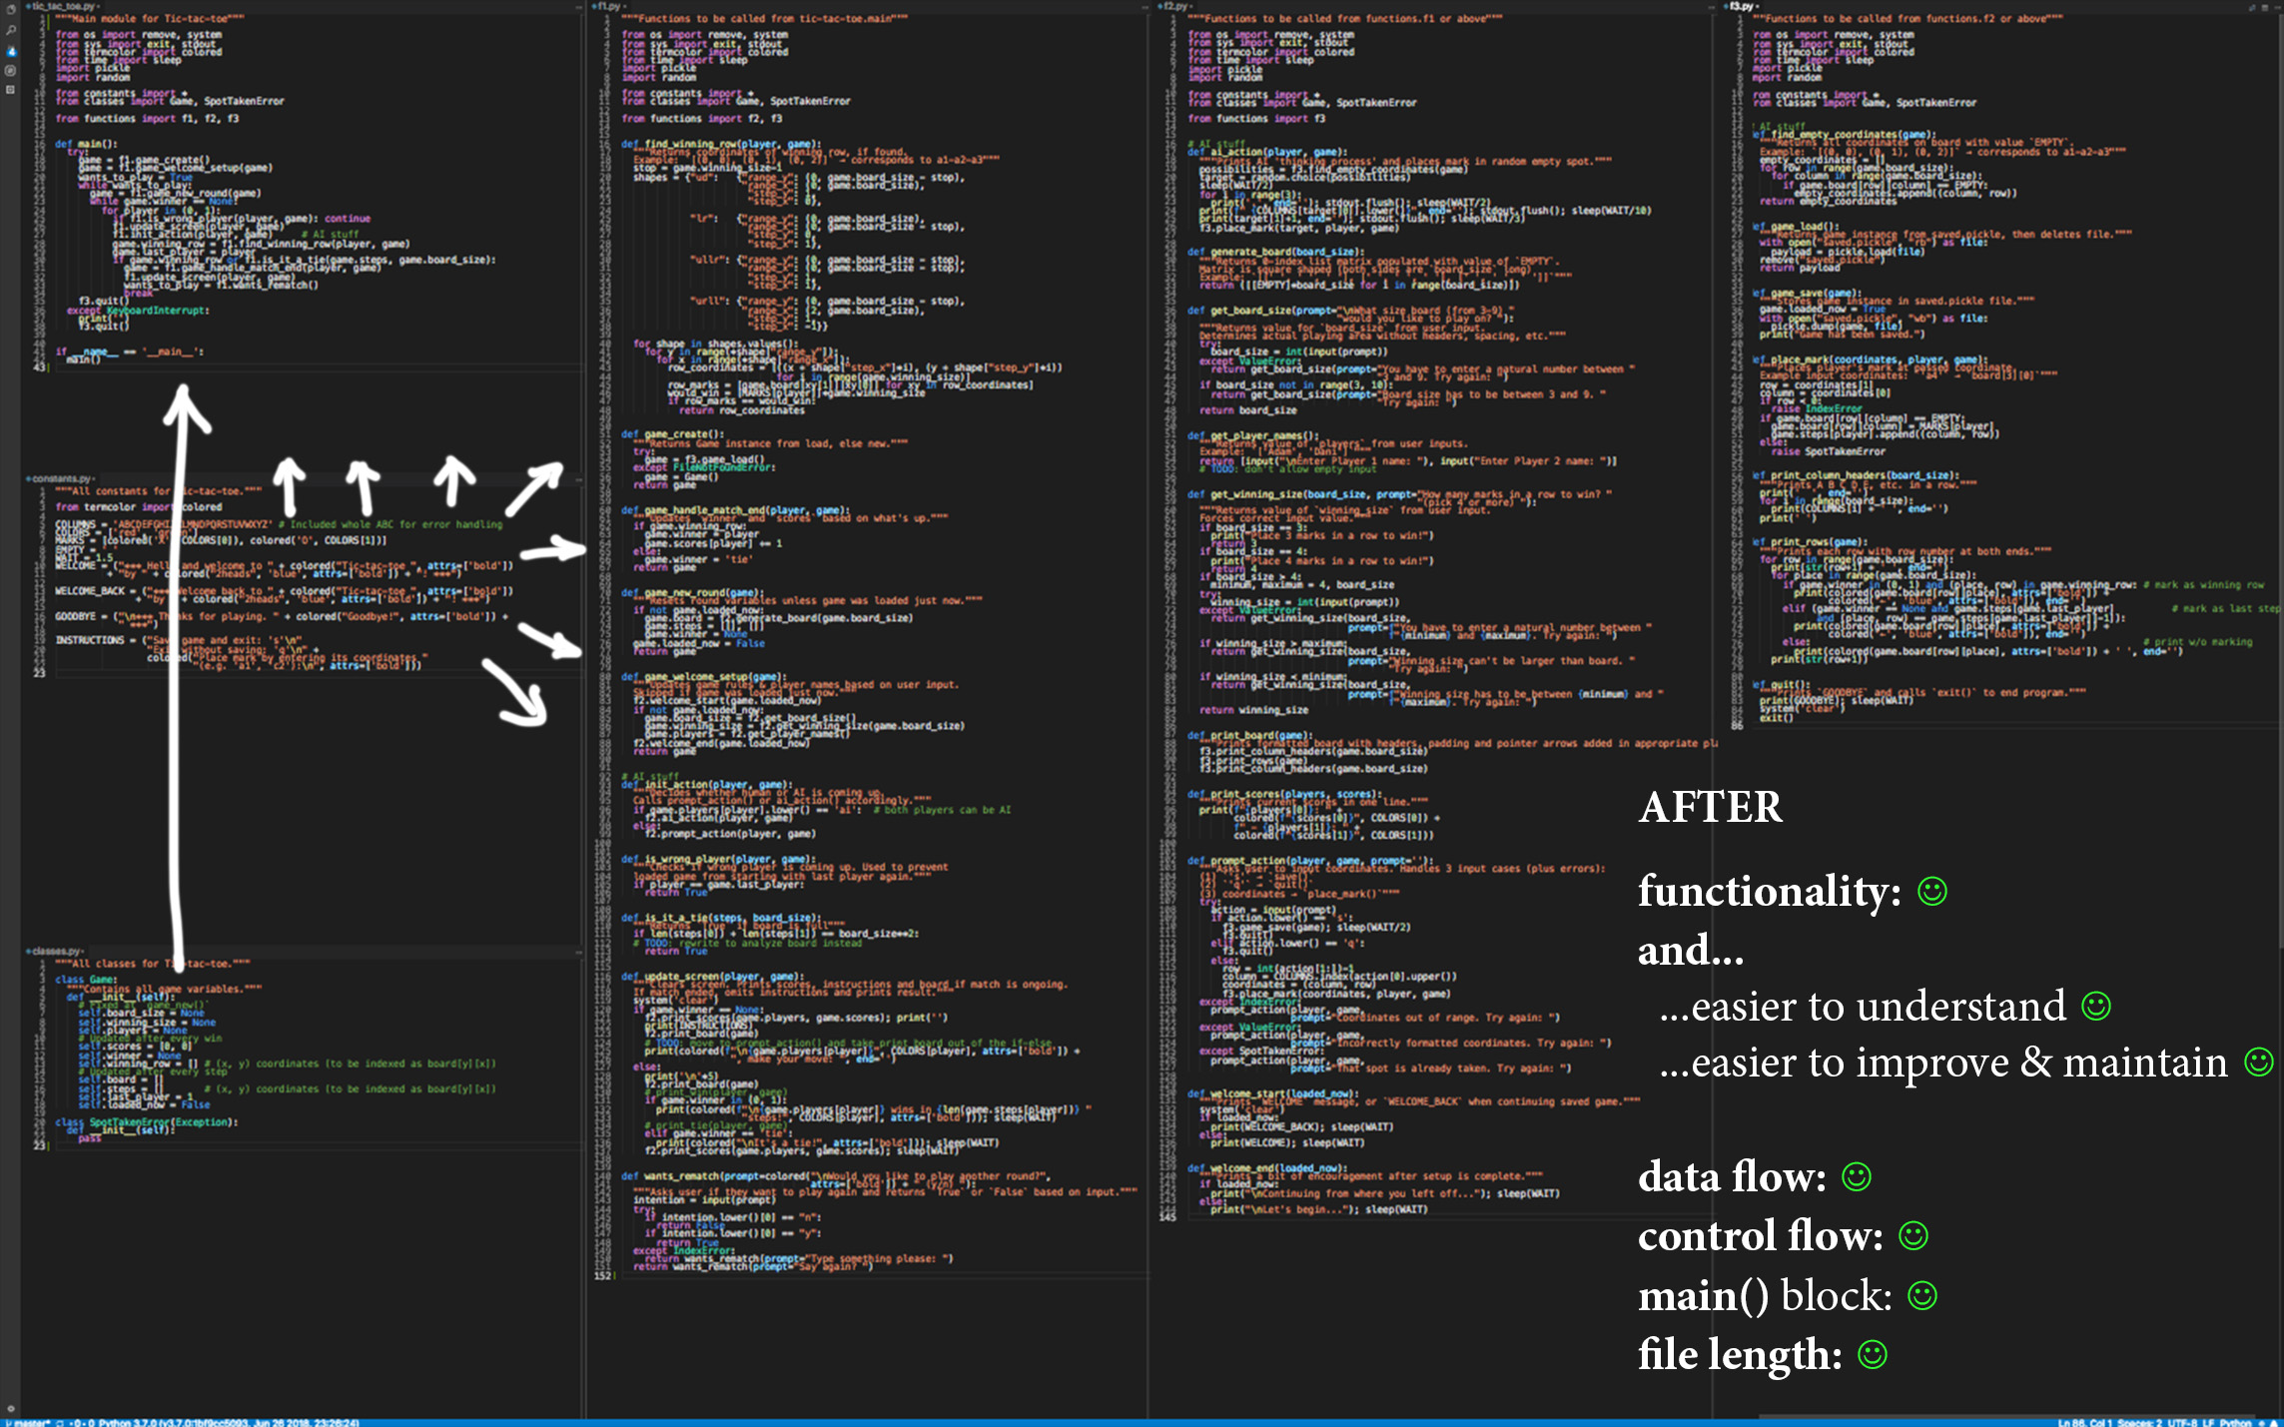

Slide 29
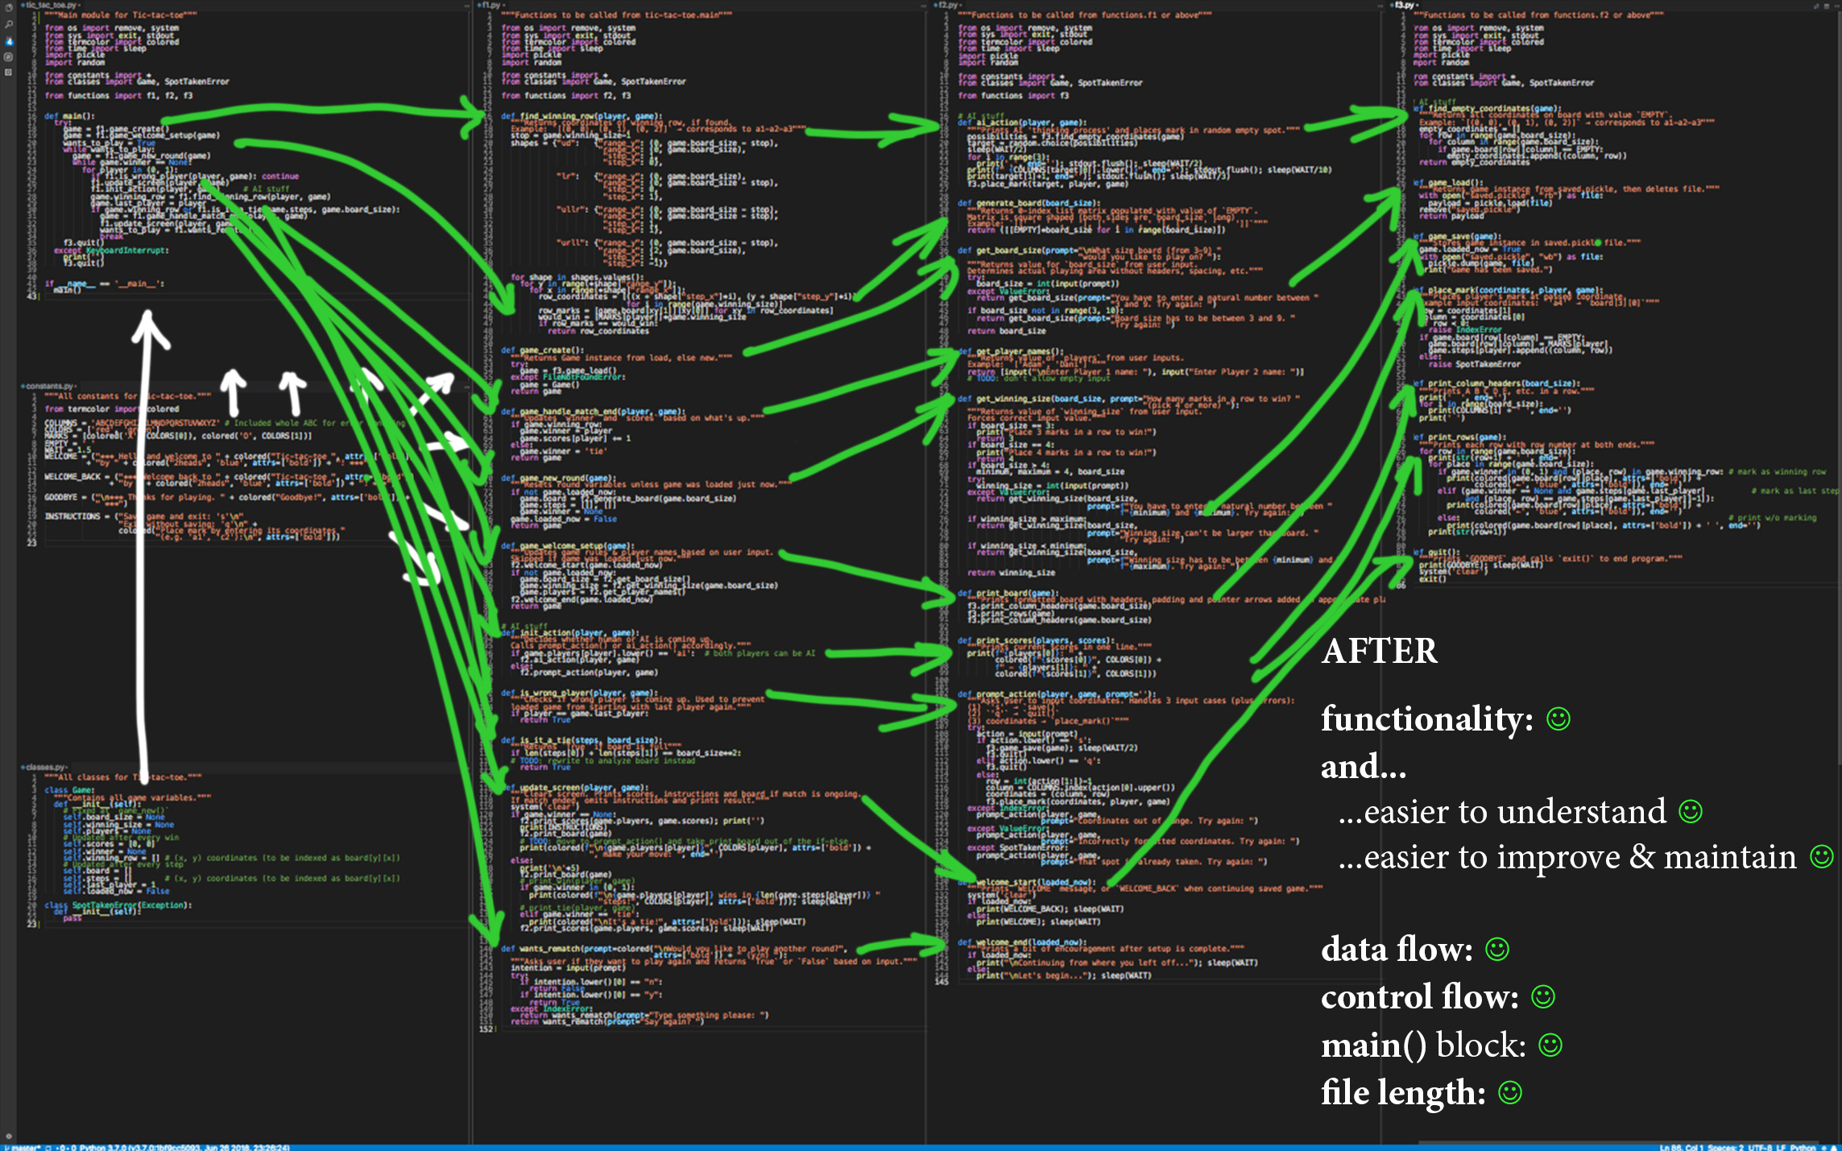

Slide 30
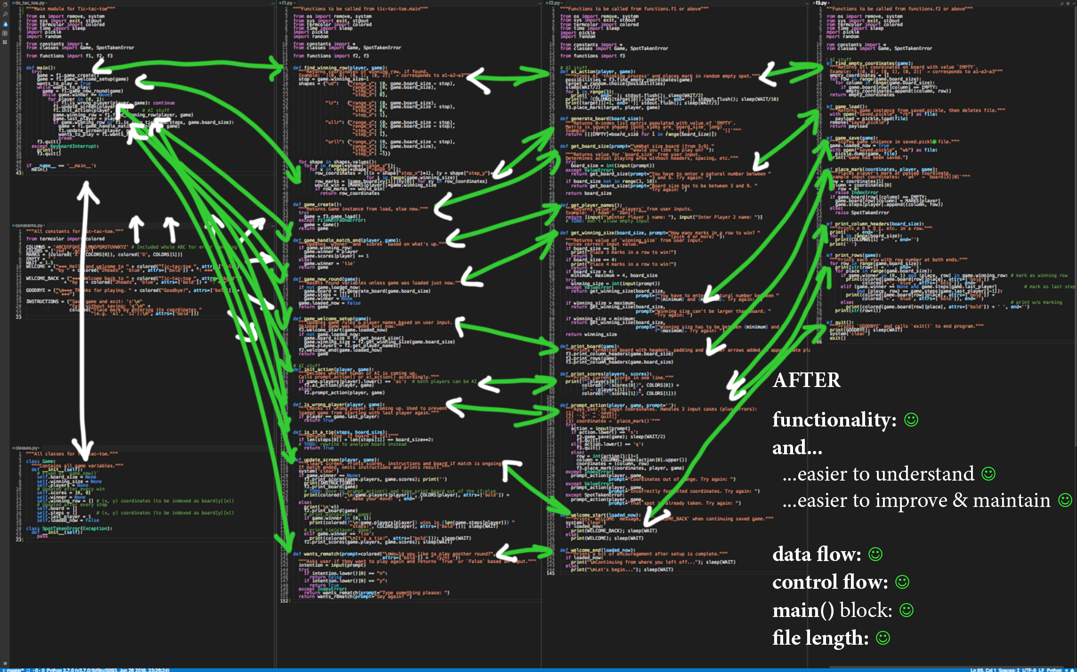

Slide 31
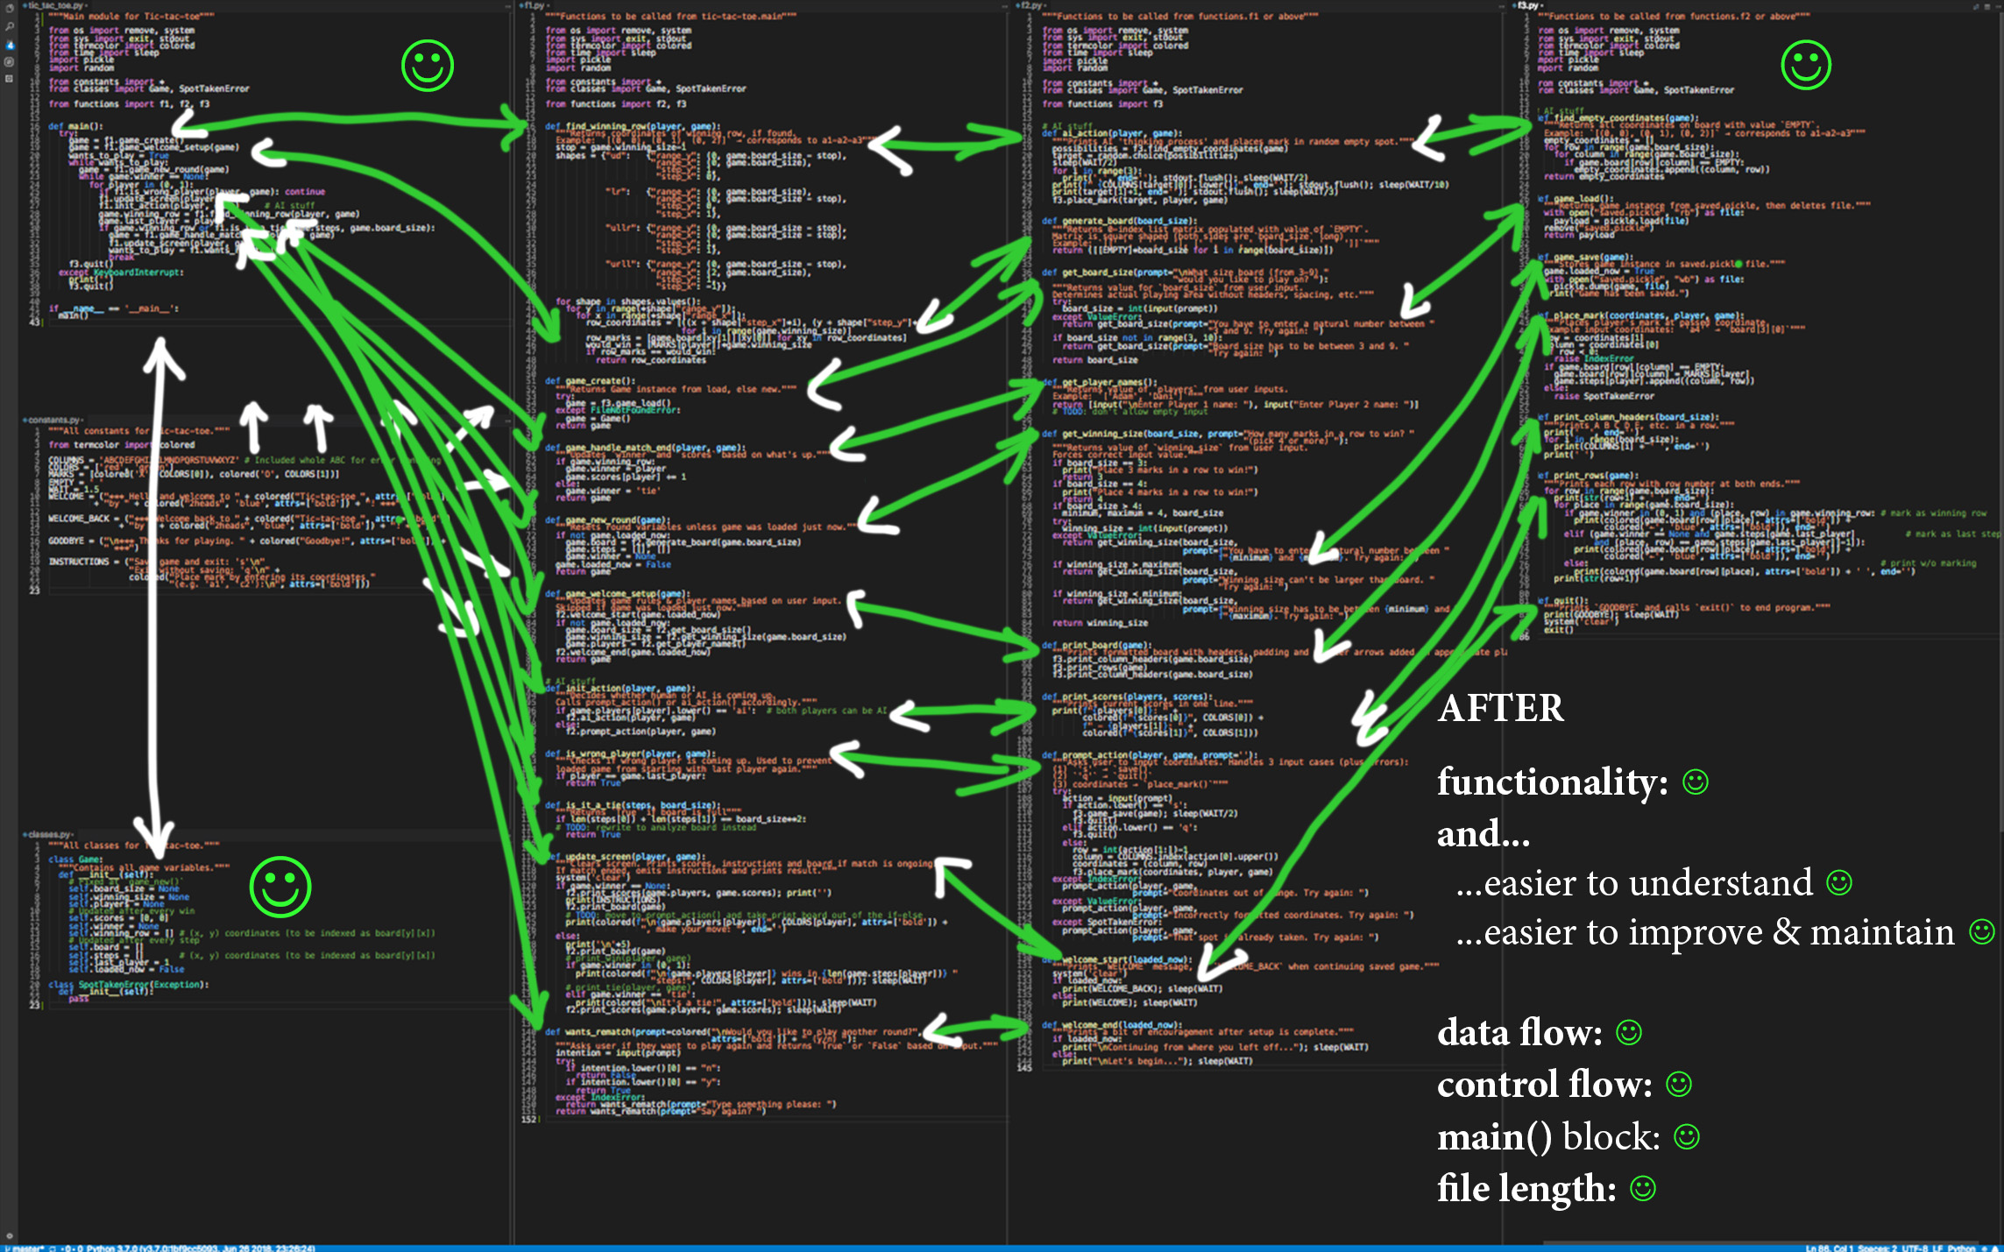

Slide 32
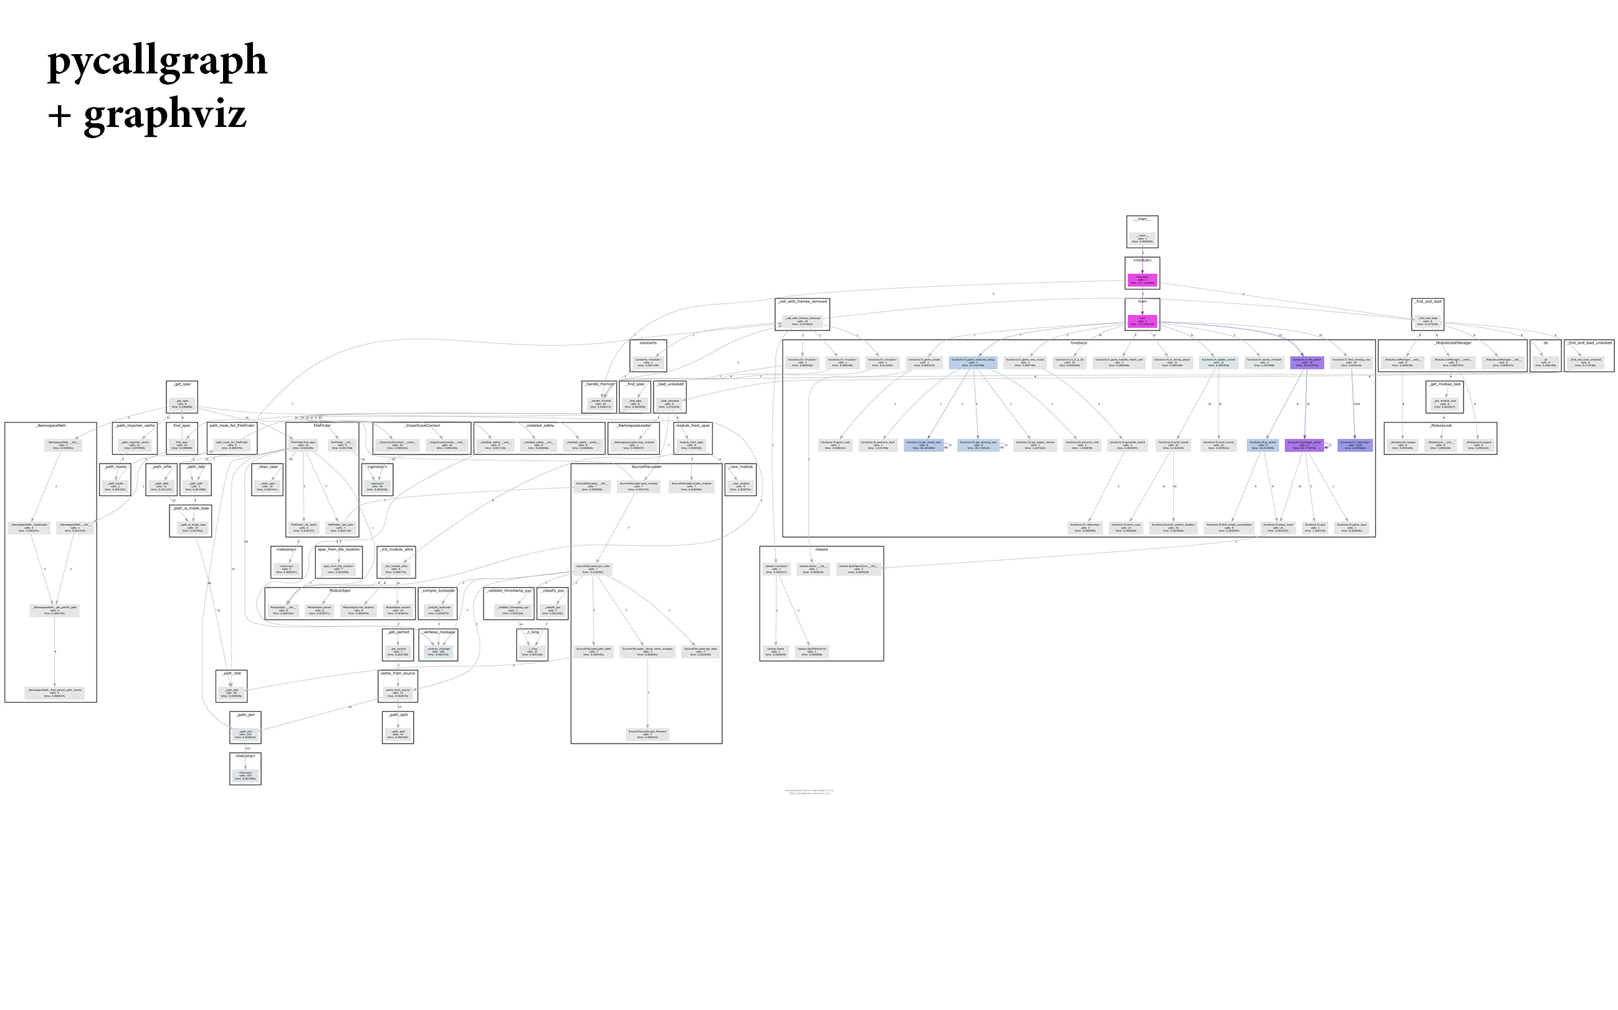

Slide 33
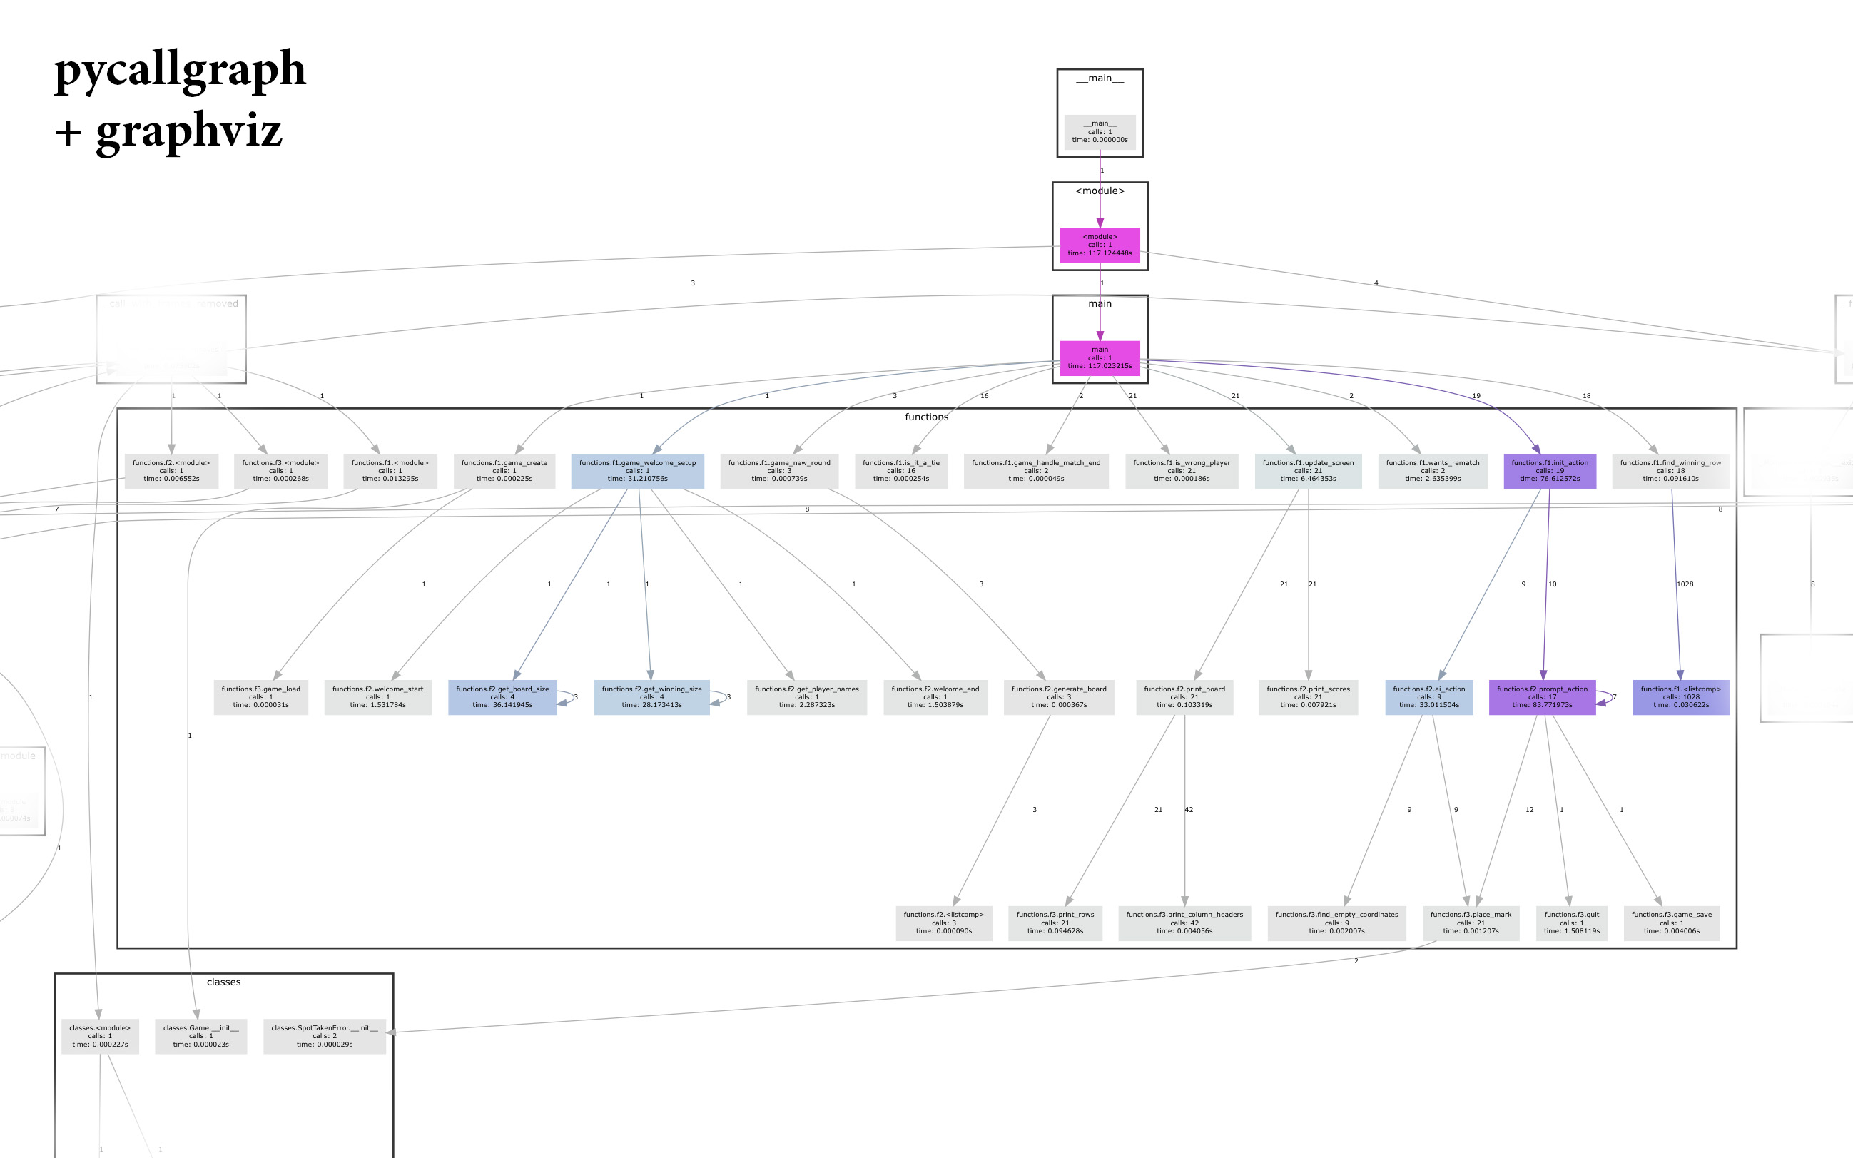

Slide 34
2heads - Tic-tac-toe v2.0
AI

Slide 35
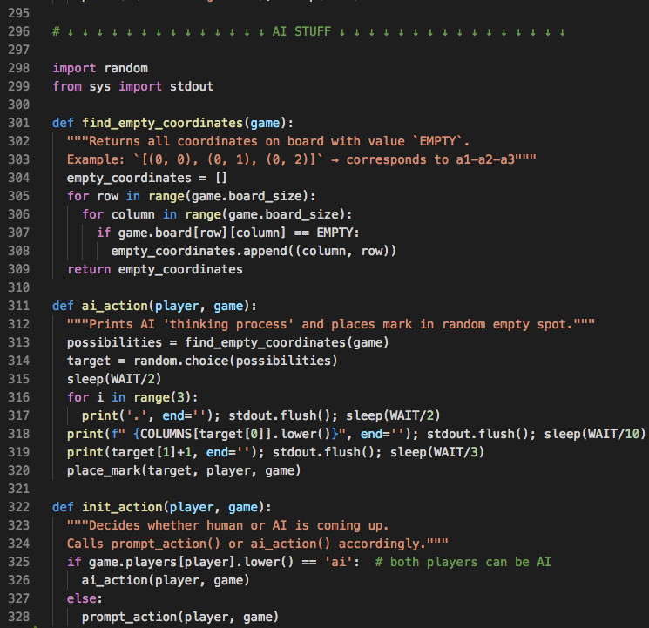

Slide 36
2heads - Tic-tac-toe v2.0
Let’s play more

Slide 37
2heads - Tic-tac-toe v2.0
Future plans

Slide 38
2heads - Tic-tac-toe v2.0
Future plans
• implement smarter AI • add convenience features

Slide 39
2heads - Tic-tac-toe v2.0
repo: http://tiny.cc/ttt2h

Slide 40
2heads - Tic-tac-toe v2.0
Thanks :)

